Slide 1
MOU Guide
Presented by: The Office for Academic Affairs

Slide 2
The process
Faculty, staff, or department internally initiates.
Deans, or other designees, submit agreement to OAA for programmatic review with memo to Provost attached.
Once programmatically reviewed and approved, we submit to the Office of General Council (OGC) with agreement and supporting documents. If programmatically not approved, the agreement gets sent back to the school.
Once received from OGC, two options:
Approved: agreement returned to school to execute signatures for both parties
NOT Approved: OAA will return agreement with OGC edits/revisions/questions requesting the school to take action.
Once OAA receives executed, partner and Morgan signed agreement, it is submitted to president designee for final approval and signature.
When OAA receives final agreement from signee, it is returned to the school as a fully executed agreement and filed accordingly.
(See flow chart.)

Slide 3
Required Reviews for approval
Programmatic Review
Legal Review
Once programmatically approved, agreements are submitted to the Office of General Counsel for approval of legal form and sufficiency.
The OGC will either approve the agreement, or not approve and provide comments/edits for the school and partner to take action/respond to.
The agreement is reviewed by the OAA (Provost) for academic approval and to ensure the agreement matches with Morgan curriculum.
If approved by the OAA, the agreement is submitted to the OGC for legal review.
If not approved, the agreement is returned to the school and no action is taken.

Slide 4
OGC Approved
The MOU will be returned to the College/School Office of the Dean by OAA. The College/School is responsible for returning agreement to the external party for approval of the revisions presented in the MOU by the General Counsel before any signatory approval from the university can be obtained.
If partner agrees to revisions:
Revised MOU with partner’s acceptance and initial’s adjacent to each revision must be returned by the partner to the College/School Office of the Dean.
The College/School Office of Dean is responsible for returning the MOUs with a signed cover memo by the Dean to the Office of the Provost indicating that the MOU as revised by the OGC has been accepted by the partner/external party.

Slide 5
Ogc not approved
Once the OGC revised agreement is provided, review with partner to accept or deny OGC recommended edits/revisions.
If partner does not agree to changes made by the OGC, the College/School Office of the Dean is responsible for returning MOUs with a signed cover memo by the Dean to the Office of the Provost indicating that the MOU as revised by the OGC has not been accepted by the partner and is being re-submitted for further legal review with the agreement containing partner edits/revisions/questions.
If partner agrees to changes made by the OGC, they must accept in the provided Word document, and initial by the revisions/comments.
Before submission, verify, and re-verify, that all revisions requested by OGC have been reviewed/changed.

Slide 6
Submission requirements
All agreements must be submitted through the mou.oaa@morgan.edu email address/google group.
Submit agreements AT LEAST 60 days prior to start date. Academic Affairs nor the General Counsel can guarantee a completed/approved review of any agreement submitted at-least two weeks before the start date.
Include all paperwork relating to agreement including memo to OAA, agreement in WORD format , and SDAT verification. (example slide 10)
Emails to mou.oaa@morgan.edu should clearly state in the body the purpose of the submission. (example slide 10)
When re-submitting due to OGC edits/comments please make sure you respond to edits/comments din the OGC provided document before submitting to OAA.
All renewals MUST have current agreement included with submission.
Contact
The OGC requires that all information regarding MOU and contract agreement must be communicated and facilitated through Academic Affairs; Please do not contact the Office of General Counsel directly.
Submission
Do NOT submit agreements directly to the Office of General Counsel or the Provost for review or signature. All MOU agreements must be facilitated and submitted through the mou.oaa@morgan.edu email address.
Emails
Please limit contact with individuals working on MOU’s directly via their personal emails. The MOU group email was established to create a database for all MOU records and communication.
PDF Copies
Do not submit agreements in PDF format. You may provide PDF copies if you are submitting for a renewal or if you are providing the partner signed copy of the agreement. WORD versions need to be included.

Slide 7
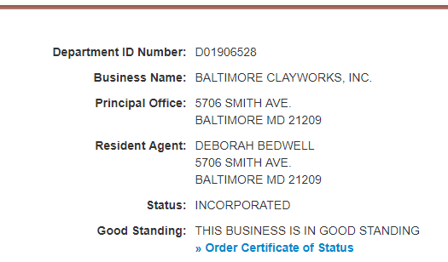
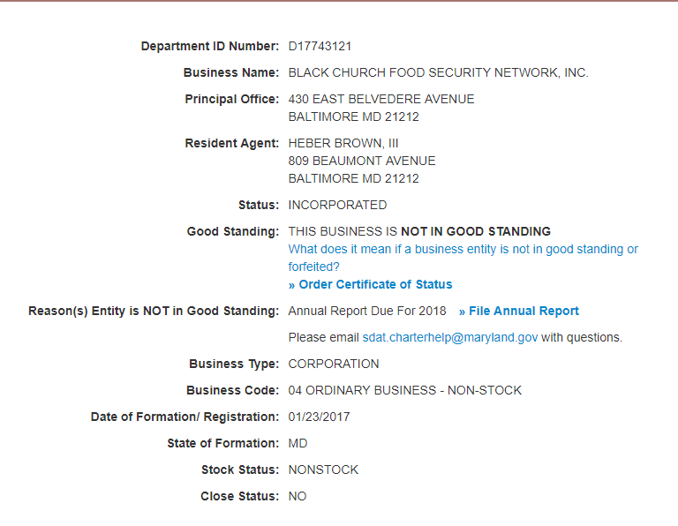
SDAT Verification Business Entity Search– Maryland Business Express (Maryland.gov)
Please submit the SDAT verification for all in-state proposed agreements.
The business must be in good standing.
The address on the proposed agreement must match the SDAT registered address. (No P.O. boxes)

Slide 8
Required Memo information
Required information
Do not include
Name of partner and purpose of agreement
Type of agreement (clinical, field, etc.)
Duration of agreement
New or Renewal Agreement (renewal must include current agreement)
Does it utilize an OGC approved template? If not, provide explanation.
Action you are requesting (initial review, resubmission, signature for execution)
“Expedited” term unless a discussion has already taken place between the Dean and Mr. Nicholas Kovach. Academic Affairs needs to be notified of the circumstances needed for an expedited review.
Back-dated or incorrect dates:
The OGC does not approve agreements that are back-dated from the submission date. Agreements need to be predated for legal approval.
When submitting and resubmitting agreements, the memo and the agreement dates need to be updated accordingly. All dates submitted must match.

Slide 9
Memo example

Slide 10
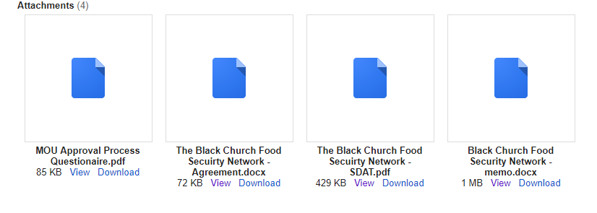
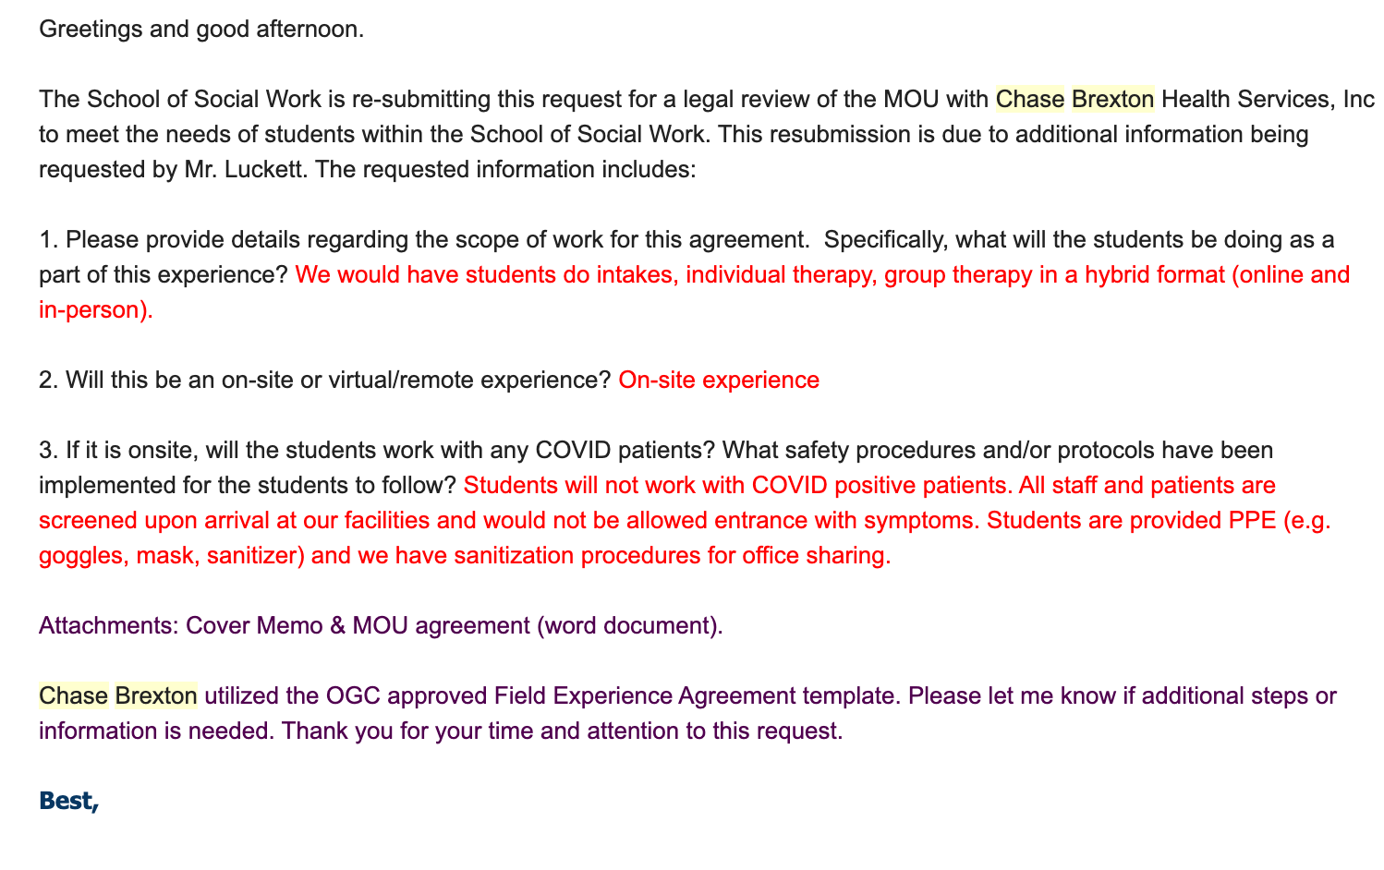
Submission examples

Slide 11
Office of general council
The minimum legal review period is 10 business days.
The OGC communicates directly with the Office for Academic Affairs for all MOU agreements. The OGC is only to be contacted through submitting a request to Academic Affairs. If the OGC chooses, they may directly contact the Dean to inquire about agreements.
The OGC does not accept PDF formats for any agreement submission. The only exception is if you are providing a copy of a previously signed agreement – a WORD version of the new agreement must still be attached.
Requires acceptance from partner of edits (accepting changes) in document to continue legal review and responses from the partner or school to the OGC provided questions provided in the document. Do not re-submit without approving/responding to edits and comments in the OGC provided document.
Academic Affairs does not contribute to the edits, revisions, comments, or non-approval of agreements by OGC.

Slide 12
KEY FACTS
Submit all International agreements to the Department of International Affairs for approval before submitting to AA.
Every submission requires a NEW MEMO.
Status updates are to be requested via mou.oaa@morgan.edu or found on the tracking page. Email inquires sent to any other emails will not be followed up.
See Beta site. Academic Affairs Information Hub

Slide 13
QUESTIONS. COMMENTS. CONCERNS.

