Slide 1
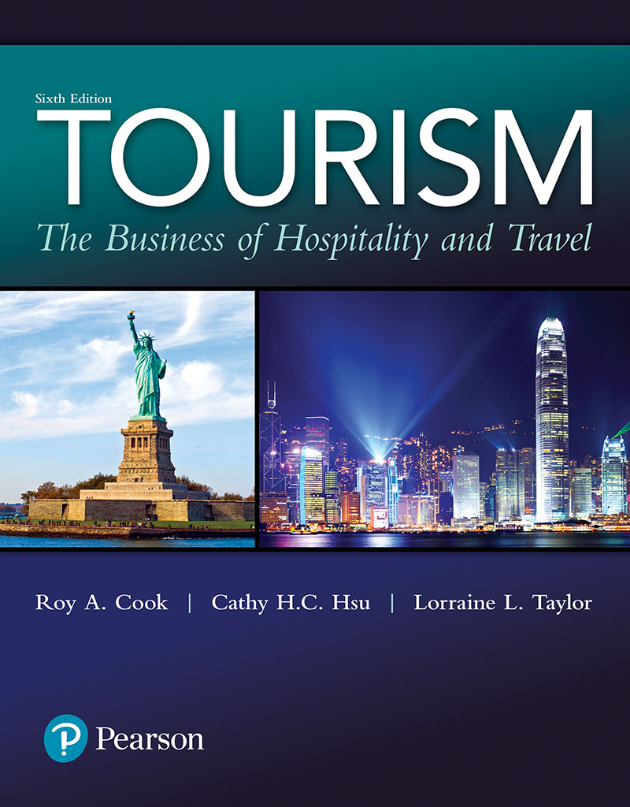
Tourism: The Business of Hospitality and Travel
Sixth Edition
Chapter 9
Attractions and Entertainment

Slide 2
Learning Objectives (1 of 2)
Describe the major classifications of attractions and entertainment in the tourism industry
Understand the differences among heritage attractions, commercial attractions, and live entertainment
Identify key marketing, management, and financial issues facing attractions and entertainment operations

Slide 3
Learning Objectives (2 of 2)
Describe major types of heritage attractions
Describe major types of commercial attractions
Describe major types of live entertainment alternatives

Slide 4
Attractions and Entertainment
People have always traveled to experience the special attraction of distant places
Attractions and entertainment provide the opportunity to participate in a variety of leisure activities, filling leisure time of tourists
Natural attractions and festivals are traditionally popular
Alternatives range wider nowadays
Notes:
People have always been attracted to new, unusual, or awe-inspiring attractions and events in every corner of the world.
No matter whether it is the chance to attend a rock concert, to witness Shakespeare being performed in the rebuilt Globe Theatre, to climb to the top of the Eiffel Tower, or to view the solitude and majesty of Uluru (Ayers Rock), tourists are constantly seeking new sights, sounds, and experiences as well as the opportunity to participate in a variety of leisure activities.
Tourists, whether visiting friends and relatives, traveling for pleasure, conducting business, or attending a professional meeting, tend to seek out a variety of attractions and entertainment alternatives to fill their leisure time. When traveling, we may con-tinue to participate in many of our favorite leisure and recreational activities, but we also seek to see, do, and experience new things
Q) Attractions differ from events in all of the following aspects EXCEPT ________.
A) visitor attendance and cash flow of attractions are typically influenced by seasonal changes
B) attractions are not-for-profit
C) most attractions are permanent
D) attractions may be either natural locations or constructed facilities

Slide 5
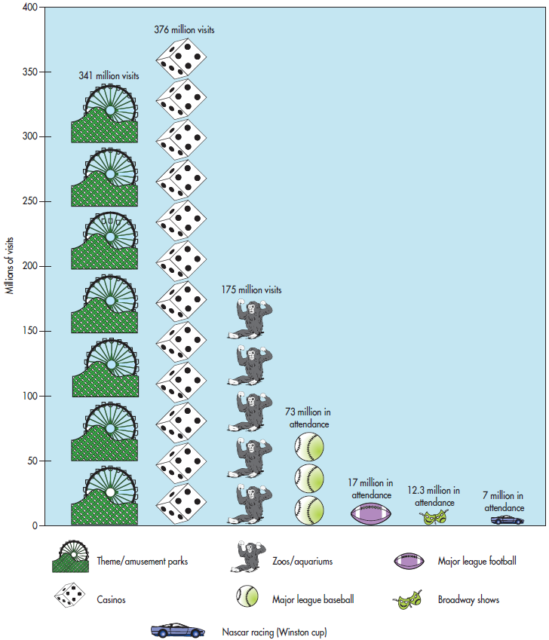
Figure 9.1 Entertainment Activities Enjoyed by North Americans
Notes:
Figure 9.1 provides a brief glimpse at some of the attractions and entertainment alternatives North Americans find most attractive.

Slide 6
A World of Opportunities
The menu of attractions and entertainment is almost limitless
Three broad categories are used for the discussion
Heritage attractions
Commercial attractions
Live entertainment

Slide 7
Table 9.1 An Attractions and Entertainment Sampler
Notes:
As shown in Table 9.1, each of these broad categories can be further classified into more specific subgroup
What would you add to this list?
Each of these attractions or live entertainment opportunities has its own special appeal and place on the menu of leisure-time offerings.

Slide 8
Foundations for Understanding Attractions and Entertainment (1 of 2)
Attractions and entertainment are similar in some ways
Choices of travelers about how to use their leisure time
Planned around natural locations and historical sites, or activities, themes, and events
May be operated on a not-for-profit or a for-profit basis
Notes:
Attractions are similar in some ways to live entertainment alternatives. Visiting attrac-tions or enjoying entertainment opportunities require travelers to make choices about how they will use their leisure time. Some attractions are planned around historic sites and natural settings, whereas others are designed and constructed around planned activities, themes, and events. Depending on the purpose or setting, they may be con-trolled and operated by not-for-profit organizations that are dedicated to preservation and interpretation or by commercial organizations dedicated to meeting guests’ needs while making a profit. Live entertainment opportunities may also be found in these same settings and may be operated on a not-for-profit or a for-profit basis. However, there are some key differences between attractions and live entertainment venues.

Slide 9
Foundations for Understanding Attractions and Entertainment (2 of 2)
Key differences between attractions and entertainment
Attractions: Natural locations, objects, or constructed facilities that have a special appeal to both tourists and local visitors
Entertainment alternatives are usually temporary
Events (e.g., fairs, festivals) are always temporary
All attractions are influenced by seasonal changes, while entertainment can be planned to take advantage of the seasonality
Notes:
Attractions are natural locations, objects, or constructed facilities that have a special appeal to both tourists and local visitors. In addition to these attractions, tourists and other visitors are also drawn to see and be part of a variety of live enter-tainment opportunities. Although most attractions are permanent, entertainment alternatives are often temporary. In contrast, events such as fairs and festivals are temporary attractions that include a variety of activities, sights, and live entertainment venues. In addition, visitor attendance, as well as the financial fortunes of almost all attractions, is influenced by seasonal changes, whereas entertainment venues can be planned to take advantage of seasons and tourism flows. As can be seen in Figure 9.2, even at a popular location such as White House, there are definite highs and lows in attendance patterns.
Many heritage attractions as well as amusement and theme parks are heavily used during the summer months, they may experience much less traffic in the winter months and so they close down.
Yet, these attractions may still have very appealing shoulder seasons, which can meet the needs of many visitors and still gener-ate sufficient revenues to cover operating expenses and/or generate a profit

Slide 10
Seasonality (1 of 3)
Seasonality is often a major characteristic of demand for attractions
When seasonality is severe, attractions may only operate during part of the year
Managers try to increase attendance during shoulder and off-season
Notes:
This seasonality of demand raises some key operating concerns for attractions. First, from a marketing perspective, how can more visitors be attracted during less popular shoulder seasons and how can they be encouraged to spend more time and money during their visits? Second, from a management perspective, how can large numbers of employees be recruited and trained in a short period of time to deliver high-quality customer service? Finally, from a financial perspective, how can cash flow be managed so that enough money is available to meet payroll and other operating expenses during the busy periods while retaining enough funds to meet maintenance and administrative expenses that occur on a year-round basis? Attraction operators have a variety of alternatives to address these concerns.
Q) Which of the following is NOT a solution to cash flow management problems for attraction operators?
A) paying flat salaries to students who stay throughout the season
B) recruiting and training retirees and college students during the busy season
C) selling seasonal passes at the end of the season or before the season begins
D) negotiating a line of credit and extended payment terms with suppliers

Slide 11
Seasonality (2 of 3)
Recruiting, training, and retaining employees is a special challenge for highly seasonal attractions
Cash flow needs to be carefully planned to have funds when operating expenses are incurred
Notes:
From a financial perspective, how can cash flow be managed so that enough money is available to meet payroll and other operating expenses during the busy periods while retaining enough funds to meet maintenance and administrative expenses that occur on a year-round basis? Attraction operators have a variety of alternatives to address these concerns. In an attempt to address the slump in attendance and revenues during off-peak peri-ods, attractions are developing and using special events to attract more visitors
To gen-erate shoulder season attendance, marketing efforts have been altered to target groups of potential visitors with flexible schedules such as mature travelers and families with students on year-round education calendars. In addition, activities have been added to match the seasons. For example, winter snow sport resorts have added mountain biking and alpine slides to attract summer visitors, and amusement and theme parks are hosting large groups at special promotional prices during traditionally slow shoulder seasons. Attractions are also cooperating in their marketing efforts. “To help boost attendance, the Toronto Metro Zoo has entered into cross-promotions with Paramount’s Canada’s Wonderland, a large amusement park located about 30 minutes from the zoo
Attracting and retaining the traditional pool of high school-and college-aged employ-ees through the entire busy season has been accomplished through implementing wagescales that increase as the season progresses and the payment of completion bonuses if an employee stays through a specified target date. In response to fluctuating demand, many seasonal operations are also finding it helpful to recruit older workers, especially retirees who still want to be active in the workforce or simply want to supplement their incomes. No matter what the source of employees, managers must maintain a continuous recruit-ing and training process to fill vacant slots created by employee turnover

Slide 12
Seasonality (3 of 3)
Managers often add complementary activities to try to generate visitors; e.g., mountain biking at ski resorts
Strategies for staffing for seasonality
Strategies for seasonal cash flow management
Notes:
Attracting and retaining the traditional pool of high school-and college-aged employ-ees through the entire busy season has been accomplished through implementing wagescales that increase as the season progresses and the payment of completion bonuses if an employee stays through a specified target date. In response to fluctuating demand, many seasonal operations are also finding it helpful to recruit older workers, especially retirees who still want to be active in the workforce or simply want to supplement their incomes. No matter what the source of employees, managers must maintain a continuous recruit-ing and training process to fill vacant slots created by employee turnover

Slide 13
Heritage Attractions
Museums and historical sites
Zoos and aquariums
Parks and preserves
Fairs and festivals
Notes:
Heritage attractions can be found in a variety of shapes, sizes, and locations through-out the world. These attractions may range from a small community museum dedi-cated to preserving memories and experiences to incredible feats of human ingenuity and determination such as the Great Wall of China and other World Heritage Sites. But heritage attractions are more than just museums, monuments, and archaeological treasures. They also include showplaces for natural wonders such as botanical gardens and aquariums as well as parks and preserves that are dedicated to public enjoyment and the protection of natural resources. In addition, fairs and festivals create special venues for celebrating and sharing a variety of accomplishments and cultural activities.
Today people are attracted by the diverse cultures of other people and the past that are displayed in museums. Research shows that when visiting museums, most visitors expect an experience that can be described as “easiness and fun.” However, there are differences in what these visitors expect based on demographic segments. For example, females with a higher educational level usually expect a museum-visiting experience like most others of easiness and fun; whereas older and married participants with higher incomes often expect historical reminiscences. These museumsand heritage sites are managed by professional curators, and interpretive programs are frequently conducted by docents who volunteer their time or work for very little pay
Large collections of animals, which were originally called menageries, have served as magnets for visitors since the times of the ancient Chinese, Egyptians, Babylonians, and Aztecs. Modern zoos (sometimes referred to as zoological parks) now come in many sizes and can be found throughout the world. The Philadelphia Zoo was the first (1859) location in the United States dedicated to the large-scale collection and display of animals. Some of these zoos are very large, creating a great deal of public interest and public-ity as well as generating significant international tourism traffic. This interest and traffic is based on unusual exhibits, collections of animal species, and efforts to re-create the natural setting found in the wild. Even the Walt Disney Company is banking on the continued draw of zoos. Disney’s Animal Kingdom theme park, which features a blend of live displays of existing animal species and animatronic displays of species from the past, such as dinosaurs, has proven to be an attractive tourism destination. From both a management and market-ing perspective, research shows that improving the zoo environment and demonstrating a concern for animal welfare were important for achieving overall visitor satisfaction levels.
Parks and Preserves:The importance of parks as major tourist attractions was ushered in with the ded-ication of Yellowstone National Park in 1872. The U.S. National Park Service has now expanded to include a variety of sites dedicated to the preservation of nature and heritage. The 411 units within the park system are grouped into 20 designations (see Table 9.2) including national park, national monument, national scenic trail, and national preserve. As a not-for-profit government agency, the
National Park Service depends on appropriations as well as other sources of revenues. These other sources include admission (user) fees as well as revenues generated from over 650 concessionaires that supply a wide range of goods and services from food and lodging to transportation and souvenirs.
Fairs and festivals hold unique positions in the attractions and entertainment segment of the tourism industry because they are a little bit of everything—heritage attractions, commer-cial attractions, and live entertainment.
Q) Heritage attractions include all of the following EXCEPT ____Theme Park____. A) parks and preserves B) zoos and aquariums C) theme parks D) museums
Q) Which of the following statements is NOT true about museums?
A) The diverse cultures of other people and the past that are displayed in museums attract tourists.
B) Countries are taking steps to preserve historic treasures and attract visitors through active restoration and interpretive programs.
C) The number of available museums throughout the world is decreasing.
D) The types of museums from which visitors can choose include general, art, history, science and technology, military, and natural history.

Slide 14
Commercial Attractions
Amusement parks
Parks with rides and other entertainment activities
Theme parks
Similar with amusement parks, but have some unique characteristics
Create a destination in themselves
Disneyland was the first theme park
Notes:
In addition to the heritage attractions just discussed, a host of commercial attractions have been developed to meet travelers’ leisure-time needs. Whether it’s the thrill of the roller-coaster plunge, the excitement of gaming, or the joy of an armload of boxes after a day at the mall, both tourists and locals welcome the opportunity to visit and enjoy these attractions.
The first amusement parks, which were called pleasure gardens, were built in England and France.. As the name pleasure garden implies, these attractions began as manicured gardens designed to provide a temporary escape for city dwellers from the everyday drudgeries of life. Rides such as carousels, games, and food and drink stands were added to these pleasure gardens to meet guest needs.
The distinction between amusement and theme parks is beginning to blur, but there are several unique char-acteristics that set them apart. Theme parks create a destination in themselves. By combining entertain-ment, food, and beverages and an environment dif-ferent from that found outside the gates, visitors are allowed to escape reality as they enter. Through the magic of technology and elaborate staging, theme parks can replicate almost any location in the world. As visitors are transported into this simulated environ-ment, they are afforded the luxury of being in another location without the expense or any of the potential problems of faraway travel.
“The contemporary American typically associates theme parks with concepts of per-manence, gardened park-like settings and single price admission” (p. 51).13
Theme parks
meeting these criteria range from elaborate parks such as Disney World in Florida and Canada’s Wonderland in Toronto to local and specialty theme parks such as Worlds of Fun in Kansas City, Missouri, and Six Flags over Georgia, in Atlanta, providing a wide range of choices for the consumer. To differentiate product offerings and compete suc-cessfully, theme park operators must become more aware of consumer perceptions and
From an operating point of view, parks must create a fun atmosphere and be clean and visually pleasing. There are several core conditions that must be met by theme park operators to retain repeat patronage and attract new patrons.
Q) To compete successfully, theme parks must do all of the following EXCEPT ________.
A) provide visually pleasing and exciting park facilities
B) become more aware of consumer perceptions and concerns
C) work out the logistics of people flow
D) standardize design irrespective of target market

Slide 15
Gaming (1 of 2)
Legalized in Nevada in 1931 to attract tourists during the depression
Explosive growth in the United States, Macao, Singapore, and Canada during the past few years
Notes:
Casino gaming has always been popular and available in many parts of the world, but it has experienced explosive growth in popularity and availability in the United States, Macao, Singapore, and Canada during the past few years. When gaming was legalized in Nevada in 1931 to attract tourists during the Depression, few would have envisioned that some type of gaming operation would one day be found within easy access of so many people in so many locations. The same type of phenomenon happened in Macao in 2003 when China eased visa requirements, and gaming exploded as tourists flooded in.
With the advent of more locations, accessibility, and new technologies, the char-acteristics of gaming as a leisure-time activity have changed. Currently, there are five broad categories of gaming alternatives:
1. Traditional, full-scale casino gaming, including well-established locations in Atlantic City, Las Vegas, London, Macao, and Monte Carlo
2. Historic, limited-stakes operations such as those in Colorado’s mining towns
3. “Dockside” (riverboat) casinos, such as those operating in Missouri and Illinois, and on the Mississippi Gulf Coast
4. Gaming on Native American reservations varies all the way from limited-stakes, small-scale operations such as the Sky Ute Casino in Ignacio, Colorado, to large-scale Vegas-style operations such as Foxwoods on the Mashantucket Pequot reservation in Connecticut
5. Casino on ocean cruises where the slot machines and gaming tables begin operation when the cruises reach international waters

Slide 16
Gaming (2 of 2)
Five primary reasons for the increase:
Voters approve because it serves as a "voluntary tax" that increases government revenue
More people than ever before are choosing casino gaming as an acceptable leisure activity
Popular among retirees, whose numbers continue to grow
Marketing programs help attract the previously ignored "low roller"
Expanded availability of gaming opportunities
Notes:
With the advent of more locations, accessibility, and new technologies, the char-acteristics of gaming as a leisure-time activity have changed. Currently, there are five broad categories of gaming alternatives:
Q) ________ tend to play games of skill more than slot machines, which are games of luck:
A) Day trippers B) Family vacationers
C) Low stakes/new adopters D) High rollers

Slide 17
Gaming Alternatives
Four broad categories of gaming alternatives
Traditional full-scale casino gaming; e.g., Las Vegas, Atlantic City
Historic, limited-stakes operations; e.g., those in Colorado's mining towns
Dockside (riverboat) casinos
Native American reservation gaming operations which vary from small to large-scale Vegas-style casinos; e.g., Foxwoods in Connecticut

Slide 18
Table 9.4 Milestones in Gaming's History and Growth
Notes:
Macau has the highest gaming revenue.

Slide 19
Gaming Segments (1 of 2)
High rollers: Sophisticated gamblers who often play internationally and focus on games of skill rather than luck
Day-trippers: Typically retirees, making short-duration trips to operations within easy driving distance, and tend to play slots and video gaming options
Notes:
1. High rollers. This segment is composed of sophisticated gamblers (both domestic and foreign), to whom traditional gaming was originally targeted. These players tend to be wealthy, older, and male. High rollers tend to play games of skill rather than luck.22
Gaming venues outside of the United States have been especially adept at serving this segment.
2. Day-trippers. Retirees dominate this segment. These players make several short-duration trips to operations within easy driving distance and wager relatively significant amounts per trip but tend to play slots and other video gaming options.
3. Low-stakes/new adopters. Players in this segment have discovered and accepted gaming as an interesting day or evening diversion when it is close to home or when traveling. Members of this segment include the growing cadre of aging baby boomers and their retiree parents, with the time and money to enjoy the entertainment associated with gaming. Other players in this segment are younger adults who grew up with computers and playing video games.23
4. Family vacationers. Owing in part to the development of complementary tourism attractions such as theme parks, this segment tends to play as an offshoot of a family vacation.

Slide 20
Gaming Segments (2 of 2)
Low-stakes/new adopters: Both baby boomers and Generation Xers who have recently accepted gaming as a leisure alternative
Family vacationers: Families who gamble as an off-shoot to other family vacation activities provided at gaming venues
Notes:
3. Low-stakes/new adopters. Players in this segment have discovered and accepted gaming as an interesting day or evening diversion when it is close to home or when traveling. Members of this segment include the growing cadre of aging baby boomers and their retiree parents, with the time and money to enjoy the entertainment associated with gaming. Other players in this segment are younger adults who grew up with computers and playing video games.23
4. Family vacationers. Owing in part to the development of complementary tourism attractions such as theme parks, this segment tends to play as an offshoot of a family vacation.
Through the use of customer loyalty programs, casinos are collecting marketing data to target each segment and cross-sell related products and services

Slide 21
Shopping
Shopping can be one part of traveling or the reason for a trip
Foreign travelers to U.S. are very likely to shop during their visit (87 percent)
Many malls are transforming themselves into tourist attractions by adding rides and other entertainment attractions
Notes:
Shopping may be part of the travel experience or it may be the primary focus of travel. Shopping is an activity that crosses all market segments
for example, the number-one tourist attraction in Minnesota is a shopping mall. The Mall of America in Bloomington, Minnesota, attracts over 43 million visitors a year.
The importance of shopping to tourism has become so significant in recent years that it has given rise to a distinct category of travel with a purpose: shopping tourism. Although the activity is distinct and growing, there is still some disagreement on how it should be defined. Even though there may be some disagreement as to a common defi-nition, there seems to be one common theme; shopping is the main purpose of the trip. “Studies on the role of shopping in tourist destination choice and experience identify four types of tourists (i.e., serious shoppers, non-shoppers, arts-and-crafts shoppers, and not-so-serious shoppers) based on a combination of the importance of shopping in destination choice and actual participation in shopping activities”
Q) Which statement is NOT true with regard to shopping as a tourist attraction?
A) Malls are also getting much bigger by adding more retail, office, and entertainment opportunities as well as additional hotel rooms.
B) Malls don't allow tourist buses in order to prevent overcrowding of stores.
C) Malls' marketing efforts provide incentives to tour operators and support from tourist bureaus to keep the shoppers coming back in large numbers.
D) Malls are transforming themselves into tourist destinations by adding amusement parks, cultural attractions, and entertainment activities.

Slide 22
Live Entertainment (1 of 3)
Sporting activities
The original sporting competitions in Greece were organized as contests, but Romans expanded the idea and staged them as games for public entertainment
Notes:
When live entertainment is added to the mix of other attraction and entertainment opportunities, travelers are faced with a broad menu of choices for filling their leisure time.
The choices of live entertainment venues can run from the deafening crowds at hallmark sporting events such as the World Cup or the Super Bowl to the serene pleasures of the ballet.
The most famous of these competitions were the Olympic Games held in Olympia.

Slide 23
Live Entertainment (2 of 3)
Sporting activities (cont’d)
Three types of sport tourism:
active sport tourism where participants travel to take part in a sport
event sport tourism where participants travel to watch a sport
nostalgia sport tourism where participants visit sports-related attractions such as halls of fame, famous stadia, or sports-themed cruises
Notes:
The idea of traveling for sports has continued to grow, and it has been suggested that, “[t]here are three types of sport tourism: (a) active sport tourism where partici-pants travel to take part in a sport; (b) event sport tourism where participants travel to watch a sport; and (c) nostalgia sport tourism where participants visit sports-related attractions such as halls of fame, famous stadia, or sports-themed cruises” (p. 207).39 Modern-day professional and intercollegiate sporting events such as football, soccer, baseball, basketball, and hockey draw millions of visitors each year to regularly sched-uled games and playoffs. Special sporting events such as the Super Bowl, the Stanley Cup Championship, the World Cup, the Pro Rodeo Championship, the Indianapolis 500, and the College World Series, to name just a few, attract international attention and vast numbers of spectators to host communities each year

Slide 24
Live Entertainment (3 of 3)
The performing arts
Classical performing arts: Theater, ballet, opera, concerts, and the symphony
Contemporary performing arts: Stand-up and improvisational comedy, rock concerts, and even the band that is playing in your favorite local “hot spot”
Notes:
The performing arts “including plays, musicals, opera, ballet, orchestral concerts, singers, comedians, dancers, and rock and pop groups” (p. 671), have been popular forms of entertainment for thousands of years. For some destinations, such as Branson, Missouri, they serve as primary tourism revenue generators; for other destinations, such as Las Vegas, Nevada and Vienna, Austria, they serve as one more ingredient in the menu of attractions and entertainment that the area can boast of to interest visitors to encourage them to extend their stay.
The classical performing arts include theater (live stage plays, not the movies), ballet, opera, concerts, and the symphony. Contemporary performing arts include stand-up and improvisational comedy, rock concerts, and even the band that is play-ing in your favorite local “hot spot.” Performing arts entertainment, especially the classical forms, are frequently offered in locations such as concert halls (the Lincoln Center in New York City, the Athens Concert Hall in Athens, Greece, and the Forbid-den City Concert Hall in Beijing, China) developed for the express purpose of show-casing the art form.

