Slide 1
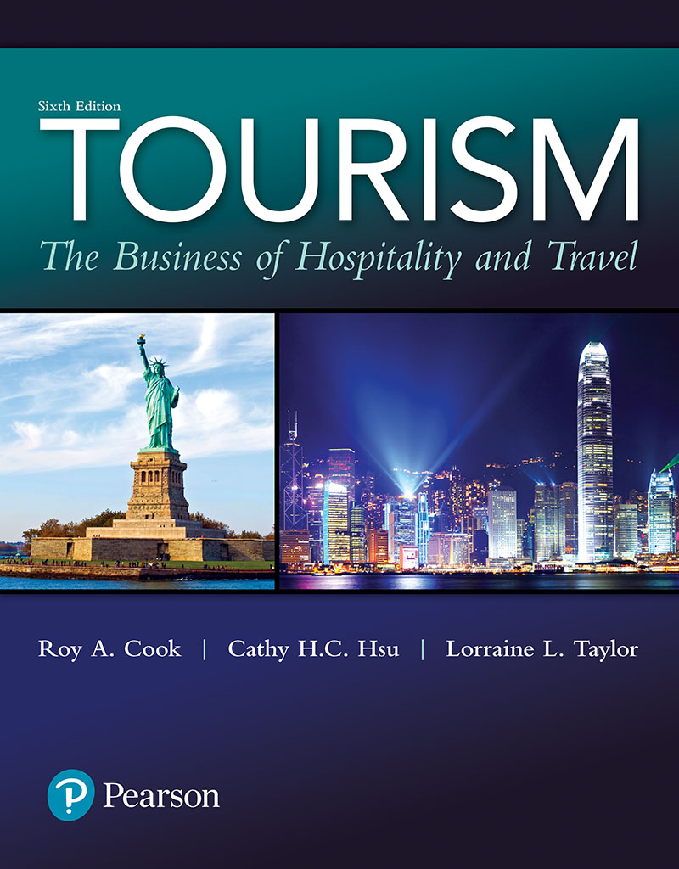
Tourism: The Business of Hospitality and Travel
Sixth Edition
Chapter 8
Food and Beverage

Slide 2
Learning Objectives (1 of 2)
Explain how travel and other events in history have influenced the growth and acceptance of different foods and beverages
Discuss the impact of science and technology on foods and beverages
Explain the importance of rhythm, timing, and flow in foodservice operations

Slide 3
Learning Objectives (2 of 2)
Discuss the importance of a menu and its impact on production and service delivery
Identify the important operational and financial concerns faced by foodservice managers
Describe how foods and beverages can add value to other tourism services

Slide 4
Foods and Beverages
Provision of foods and beverages fulfills not only basic human needs but also special tourism needs
Culinary tours emerged to satisfy culinary tourists
Tourists provide an important source of revenue to many foodservice operations
On average, tourists spend about 25% of their total travel expenditure on foodservices
Notes:
Foods and beverages are not only instrumental in filling a number of basic human needs, but they also fill special tourism needs.
Culinary tours have recently emerged as a significant component of the overall tourism industry. Research has shown that culinary tourists, those who travel to participate in cooking classes, dine out in unique locations, sample wines, and attend food festivals and farmers’ markets, are younger, better educated, and more affluent than other travelers.
Tourists provide an important source of revenue to many, but not all, foodservice operations. “Roughly half of all travelers report that they dine out when they travel, and that doing so is the most important activity planned after tourists arrive at a des-tination.
Because F&B experiences are very personal, the thought of pleasing all these different tastes may seem like a difficult task. What may be pleasing and desirable to you may be completely unappealing to someone else. The good news is that there are fundamentals that can be followed to provide successful F&B services. In this chapter, you will learn about these principles as well as some of the marketing, management, and financial decisions that combine to create the dynamic and fast-paced working environment of F&B operations.

Slide 5
Major Influences on the Development of Food and Beverage Services
Travel and discovery
The quest to explore and conquer new lands that encouraged early travel also led to the spread of different food and beverage offerings
Foods and beverages now drive many travel choices
Science and technology
Advances in farm technology expand menu choices
Refrigeration and freezing technologies, along with the use of irradiation, help to store and transport foods
Notes:
We can trace the most important influences on the development of foods and beverages to travel experiences and innovations in science and technology. Throughout history, travel has introduced visitors to new tastes, and these discoveries continue today.
The quest to explore and conquer new lands that encouraged early travel also led to the spread of different F&B offerings. The importance of foods and beverages to the development of travel and tourism can be seen all the way from the expansion and conquests of the Greek and Roman Empires to the travels of Marco Polo.
The Greeks brought home food-related “treasures” from their travels in Egypt, Persia, Babylon, and India. These culinary treasures were later passed on to the Romans. In fact, at the height of the Roman Empire, the typical Roman cook was a male slave brought from overthrown Greece, where cooking skills and cuisine were highly developed. The Romans’ appetites for pleasurable indulgences placed these cooks in high demand and raised the status of cooking to an art form.
As the world moved into the so-called Dark Ages, travel began to diminish. The art of cooking, however, was preserved during this period because most of the rich cooking styles and the books that discussed foods and beverages were guarded in monasteries.
As Europeans began to travel to the Americas and West Indies, they returned with many native foods from those regions such as chocolate, chilies, beans, corn, tomatoes, and potatoes. Some of these items were initially avoided and treated with suspicion because they looked different and were often regarded as poisonous.
Creating the foods we enjoy involves a combination of technology, science, and a great deal of culinary and service talent.
Once people began emigrating from Europe to the “New Worlds” of North America, they brought along their favorite drinks, breads, desserts, herbs, spices, and fruits. These old favorites were combined with new foods, creating distinctive regional cuisines from New England clam chowder to hominy grits. Now, in the 21st century, the majority of people in industrialized countries can afford to travel for pleasure and, through tourism, enjoy new foods and dining experiences.
In the same way that travel has driven their development, foods and beverages now drive many travel choices, especially food-themed travel choices. F&B events attract tourists in increasing numbers to resorts, festivals, theme parks, casinos, and many other destinations.
Now more than ever before, F&B professionals can deliver on the promise “your wish is my command.”
Advances in farm technology have increased the quantity, quality, variety, and availability of foods, expand-ing menu choices all over the world. For example, aquaculture (the commercial raising of shrimp, salmon, and oysters) now brings high-quality seafood such as shrimp, salmon, and oysters to the kitchens of the world 365 days a year.
Refrigeration and freezing technologies, along with the use of irradiation, also allow foods to be stored longer and transported over greater distances without affecting quality. Continuing technological advances have also led to an array of computerized equipment such as internal temperature probes, which can be accurately programmed to regulate oven cooking and holding temperatures. These advances ensure the greatest yields and the highest-quality food products. In addition, information and new ideas about F&B preparation and presentation are now freely shared. Featured food sec-tions in magazines and newspapers, special television programs, attractive websites, professional publications, and a cable channel dedicated to food have heightened both awareness and appreciation of this segment of the tourism industry

Slide 6
Building a Culinary Heritage
Food and beverage (F&B) operations vary
Commercial restaurant operations vary from quick service to elegant, full service
Foodservice establishments also include employee and institutional food service
Notes:
- Creating the foods we enjoy involves a combination of technology, science, and a great deal of culinary and service talent. This talent can be found in many different types of F&B operations. The most common are commercial restaurants serving the general public and travelers who dine for reasons that range from need and convenience to entertainment and pleasure. Commercial restaurant operations vary all the way from fast-food (quick service) and take-out to elegant, full-service, sit-down operations. Whereas restaurants are the most typical F&B operation, they represent only one of many types of F&B services. Others can be classified into employee food service, recreational food service, transportation food service, lodging properties, banquet/ meeting and catering facilities, and institutional foodservice establishments. Most of these foodservice operations touch travel and tourism in some way.

Slide 7
The Beginnings of Modern Foodservice Practices (1 of 2)
France is credited with the first restaurant
Most early lodging places and restaurants offered a simple table d'hôte
Marie-Antoine Carême's grand cuisine led to the rise of à la carte restaurants, which feature a list of suggestions
Notes:
Independent eating and drinking establishments were the first F&B operations to evolve, and today, they still generate the majority of all F&B revenues. It all began in Paris, way back in 1765, when Monsieur Boulanger served a typical peasant’s dish: sheep’s feet (also known as trotters) in a white sauce as a restorative along with ales in his tavern. Trotters was served at the first restaurant established by M. Boulanger in France. In fact, the word restaurant comes from the French word restorante, which means “restorative.” Tavern keepers in Boulanger’s time were limited to serving beers and ales only in accordance with the controls imposed by the medieval guild system. These controls were designed to maintain standards and restrict competition. Because Boulanger was limited by law to serving beers and ales only, he was brought to court to stop the practice of serving food in his tavern. He won the case and the rest is his-tory; the door was opened for restaurants to serve food and drink together.
offered a simple table d’hôte. – a restaurant meal offered at a fixed price and with few if any choices. "a table d'hôte lunch for $6.50"
This type of menu provided little if any choice. Carême’s grande cuisine created a new style of service and range of menu choices. Menus expanded through the offering of a “carte” or list of suggestions, giving rise to the à la carte restaurant. In restaurants, à la carte /ɑːləˈkɑːrt/ is the practice of ordering individual dishes from a menu in a restaurant, as opposed to table d'hôte, where a set menu is offered.
(of a menu or restaurant) listing or serving food that can be ordered as separate items, rather than part of a set meal.
"an à la carte menu“/ as separately priced items from a menu, not as part of a set meal.

Slide 8
The Beginnings of Modern Foodservice Practices (2 of 2)
The Savoy Hotel offers the best of food and service as well as the elegant ambiance
Chef Escoffier revolutionized the methods of food service and kitchen organization
Escoffier also reorganized tasks and activities in the kitchen by creating and defining the work of stations
Notes:
Escoffier was the most famous chef of his day and is considered by many to be the father of modern-day chefs. Escoffier revolutionized the methods of food service and kitchen organization during his years of managing the kitchens at the Savoy and later the Carlton Hotel. He expanded and refined the idea of à la carte service by establish-ing carefully planned sequences of courses. For example, a typical sequence of courses for today’s full-service casual American-style restaurant might start with an appetizer and then be followed by soup, salad, entrée, and dessert.
Escoffier also reorganized tasks and activities in the kitchen, eliminating duplication of effort and improving efficiency in operations by creating and defining the work of stations. More than anyone else, Escoffier helped to focus foodservice providers on the important task of catering to guests’ needs and desires by making dining a memorable experience. This was only the beginning, as others contributed to the constantly evolving developments in foods and beverages. Table 8.1 traces the historic evolution of foods and preparation methods from the Egyptian Kingdoms to Ray Kroc’s brainchild, McDonald’s

Slide 9
Table 8.1 A Food and Beverage Timeline (1 of 2)

Slide 10
Table 8.1 A Food and Beverage Timeline (2 of 2)

Slide 11
Planning to Meet Guest Expectations (1 of 2)
Guest experience involves interrelated factors: e.g., menu design, place setting, plate presentation, style of service
Consider target segments and their desires in designing menu
Notes:
Foodservice operators are not simply in the business of providing foods and beverages; they are in the business of creating guest enjoyment. Achieving this goal requires attention to detail and preparation that begins well in advance of welcoming the first guest.
The guest experience is determined by a variety of interrelated factors from menu design and place settings to plate presentation and style of service.
Effective menu design begins with identifying target segments and planning to meet their desires. This requires asking some basic questions. What image should foodservice operations support? How many items should be offered on the menu? How diversified should the offerings be and how seasonal should they be? What impact will different menu items have on preparation, production, presentation, sales, service, and profitability?
The answers to these questions may result in a variety of menu offerings and styles of service ranging from quick-service snacks to full-service formal dining. In two studies, researchers found that, “Placing menu items at the beginning or end of their category increases their popularity by about 20% (namely the gain from 45% of the time when an item appeared in the middle of its category to 55% of the time when it appeared at one of the ends of its category)”
The second step involves the design and presentation of the menu itself. The second step in planning to meet guest expectations with foods and beverages is “designing the menu”. Seemingly simple things such as deciding what type of menu board should be placed above an ordering station or selecting the paper stock, graphics, color, font, and layout of a menu take on new importance. These decisions communicate an image to guests even before the food is presented. A theme-park guest wanting a restful break will have differ-ent expectations than a businessperson on an expense account entertaining clients. The design and presentation of the menu sets the stage for the next important decisions. The most artistic step in preparing to meet guests’ foodservice needs is “designing the plate presentation.”
The third step involves a variety of decisions that range from selecting service ware to designing place settings. These decisions may be driven by the functional demands of serv-ing as many guests as inexpensively as possible or a desire to create an aesthetically pleasing atmosphere. Plastic or paper with self-service areas for condiments may be the best selection for guests in a hurry, but the same choice would not be suitable in a fine-dining situation.
Designing the actual plate presentation is the fourth and possibly most artistic step in the process. Attention to detail in the previous steps comes to life when guests receive their selections. Once the order is delivered, whether hot dogs and fries or cha-teaubriand, the eyes always take the first taste. Even with simple dishes, the presenta-tion should be designed to fill our senses through a thoughtful combination of • color, • texture, • shape, • aroma, and • arrangement.

Slide 12
Planning to Meet Guest Expectations (2 of 2)
Choice of service ware and place settings
Artistry of food presentation on plate
Style of guest service; e.g., self-serve, Russian
Notes:
The fifth and final step in planning to meet guest expectations is accomplished when the type of service is selected for delivering menu items. Service may range from moving down a cafeteria line to formally orchestrated Russian service. Whatever the selection, the ultimate goal is meeting guests’ needs. Proper planning, as shown in Table 8.2, sets the stage for enjoyable dining experience

Slide 13
Table 8.2 Menu Planning Essentials

Slide 14
It All Comes Down to Rhythm, Timing, and Flow (1 of 2)
Brigade system, developed by Escoffier, assigns set tasks to specific personnel
Rhythm, timing, and flow of production lead to excellence in foodservice
Notes:
Developing menus and having the right equipment, ingredients, and talent to produce these items is only the beginning of a successful foodservice operation. Just like the conductor of an orchestra who brings a musical score to life, F&B managers bring menus to life.
The brigade system, developed by Escoffier, was designed to make this task possible. Under this system, each position has a station (assigned workplace) and clear-cut responsibilities. For example, one station in the kitchen makes all of the stocks and reductions needed for the bases of soups and sauces instead of having each station make its own. Although the brigade systems were originally designed for use in fine-dining establishments, they are flexible and can be modified for use in any size or style of foodservice operation and, even with new innovations, are still used today
Professionally planned menus, a properly designed and equipped kitchen, well-trained employees, and effective preparation and production systems make up the basic ingredients for delivering high-quality food and service. However, it takes more. A dedicated team constantly striving to balance the rhythm, timing, and flow of pro-duction and service delivery adds the final ingredients that bring the dining experience to life. Rhythm is the coordination of each required task and activity. To achieve this balance, managers must focus on being team leaders or coaches for their employees and move away from the authoritarian approach that has been traditionally used by foodservice managers.

Slide 15
It All Comes Down to Rhythm, Timing, and Flow (2 of 2)
Rhythm: Coordination of each required task and activity
Timing: Sequencing of each task/activity to produce desired result
Flow: Mix of rhythm and timing resulting in smooth, efficient operation
Notes:
• Rhythm is the coordination of each required task and activity.
• Timing is the sequencing of each task and activity to produce desired results. •
Flow is the combination of rhythm and timing resulting in a smooth, efficient operation.
To understand the importance of rhythm, timing, and flow, imagine the follow-ing setting. You and your friend have just been seated and presented with menus in a full-service American-style restaurant. The typical sequence of courses in this style of restaurant would be appetizer, soup, salad, entrée, and dessert. As you review the menu, you look around and notice that the dining room is full, and there are customers still waiting to be seated. You see a busser (back waiter) mov-ing a high chair toward a table; the captain (host/hostess) reseating guests who did not like their table; a server (front waiter) stopping to answer a guest’s question; and you just heard the captain take a special request from the guests at the table next to you. While you are watching all of these activities your water glasses have been filled, and your waiter has already taken and served your drink orders.
When your server takes your orders, you notice that each appetizer and entrée will have to be prepared differently. The shrimp cocktail and the mozzarella cheese sticks, just like the grilled salmon and the fettuccini Alfredo, will all come from different stations in the kitchen. Your server passes through the kitchen doors and you hear a muffled burst of activity before the doors quickly close. When the rhythm, timing, and flow of all of these activities occur as planned, the dining experience can be as pleasur-able as listening to a well-rehearsed symphony. Bon appetit!

Slide 16
Adding Value to Food and Beverage Experiences (1 of 2)
Successful F&B operators differentiate their operations by focusing on guest service, price/quality value, unique foods, or dining experiences
At one location, F&B facilities may be designed to provide service to a captive audience of guests
At another location, facilities may be designed to attract guests

Slide 17
Adding Value to Food and Beverage Experiences (2 of 2)
Properties may use F&B operations as part of their overall marketing strategy for:
Creating a desired public image and defining their place in the market
Attracting desired business
Can increase overall profitability because rooms have a greater contribution margin than does F&B
Creating new business opportunities
Notes:
- Creating a desired public image and defining their place in the market. F&B operations can have a significant impact on a property’s image in the marketplace by serving as a center for community groups and organizations, causing the prop-erty to be perceived as a point of pride in the community.
• Attracting desired business. F&B operations can be used to add quality or value to a property’s overall image by attracting individuals such as travel agents, tour operators, and meeting planners who influence travel decisions. These operations are often used to attract group business by discounting F&B items, which adds value to the total meeting package and obviates the need to discount sleeping room prices. Actions like this can increase overall profitability because rooms have a greater contribution margin than does F&B.
• Creating new business opportunities. By producing events, a property can use F&B operations to create new business opportunities. Wine tastings, celebrations, theme dinners, balls, brunches, and other combinations of food, beverage, and entertainment often entice people to visit a property. Once there, they may stay longer to enjoy the guest rooms, restaurants, lounges, pools, spas, and golf and tennis facilities. These marketing strategies can be especially effective for generat-ing business during shoulder season

Slide 18
From Ten to Ten Thousand
Many unique challenges to feeding groups on a one-time basis
Most properties have multi-purpose rooms for catering and banquets
Catering sales managers work with planners to develop a banquet event order that provides the details of satisfying the group's food and beverage needs
Notes:
- Whether it’s providing breakfast, lunch, dinner, or refreshment breaks for groups, foodservice teams must be prepared to meet their needs and budgets flexibly. There are a variety of facilities either specifically designed for banquets or that can be easily converted to meet catering needs. Most large hotels and resorts and many smaller properties have multipurpose rooms that can be used for both meetings and food functions, and convention centers and even sports arenas can be converted to feed tens of thousands of guests. The task of planning, setting up, and serving these functions falls in the capable hands of catering (also called banquet) managers and their supporting service teams.
- Catering sales managers work with clients to discover their needs for such things as meeting and exhibit space as well as F&B requirements. These requirements are then described in great detail for internal use for kitchen and service employees on a catering contract or banquet event order (BEO) form. The BEO serves as an internal form of communication that provides specific timing and instructions for the banquet service team to meet guest expectations. This level of detail becomes especially important when dealing with groups requiring a variety of services over multiple days. For example, at a four-day conference, meeting goers will likely be served breakfasts, lunches, dinners, refreshment breaks, and cocktail parties. These may range from a formal dinner-dance banquet to a self-service continental breakfast.

Slide 19
Building Profitable Operations (1 of 2)
F&B industry faces thin profit margins and fierce competition
Restaurants have high failure rate, yet a relatively long lifespan
Foodservice operators are faced with working long hours and dealing with complex problems
Notes:
Due to high competition and low profit margins, the failure rate for restaurants is 60%.

Slide 20
Table 8.3 Recipes for Restaurant Success

Slide 21
Building Profitable Operations (2 of 2)
Balancing payroll costs with productivity
Labor and food are the two largest controllable expenses of F&B operations
High employee turnover/need to find and train new employees is a constant challenge for F&B managers
Food quality and food costs are the results of effective purchasing
Controlling the cost of food by effective purchasing, receiving, and storing F&B products
Notes:
Common benchmarks used to measure performance in food service operations include sales per seat, sales per employee, daily seat turnover (NOT employee turnover).
In the restaurant industry, the number one customer demand is “quality”.

Slide 22
An Ounce of Prevention Is Worth a Pound of Cure
Food safety and sanitation are the responsibility of managers and employees
Employee training and work procedures plus properly maintained equipment lead to a safe foodservice environment

Slide 23
Table 8.5 How Foodservice Operators Are Addressing Sanitation Concerns
Notes:
Some of the more common performance measures that are used to evaluate per-formance in foodservice operations include sales per seat, sales per employee, and the number of times a seat or table turns over in one day. In the search for increased rev-enues, restaurant operators may seek to increase table turns during peak periods by speeding up the meal’s pace. However, this seemingly appealing approach should be considered cautiously as research shows that excessive speed may make customers feel rushed and hence guest satisfaction may be diminished.

Slide 24
Figure 8.1 The Bacterial Danger Zone

Slide 25
Beverages
The distillation, fermentation, and compounding of spirits has a long and rich history
Alcoholic beverages are often used in foods to enhance flavor
Beverages serve as a complement to food and the dining experience

Slide 26
Beverage Operations
Successful beverage operations depend on the same business principles as foodservice operations
Heavy taxes on alcoholic beverages and changes in consumption behaviors reduce profit margins
The use of technology in bar operations is replacing “free-pouring” practice to increase profits

Slide 27
Keeping Spirits Under Control
Legal liability of third-party injuries after serving a guest alcohol
Society's closer focus on driving and drinking
Need for training of employees to recognize intoxicated customers and respond with appropriate tactics
Notes:
Negligence (Lat. negligentia) is a failure to exercise appropriate and/or ethical ruled care expected to be exercised amongst specified circumstances. The area of tort law known as negligence involves harm caused by failing to act as a form of carelessness possibly with extenuating circumstances.

Slide 28
Coffee, Tea, Or?
Non-alcoholic beverages have become an important revenue source, especially due to the explosion of specialty items
Combinations of beverages and food enhance quality for the customers
Increase tips for servers

