Slide 1
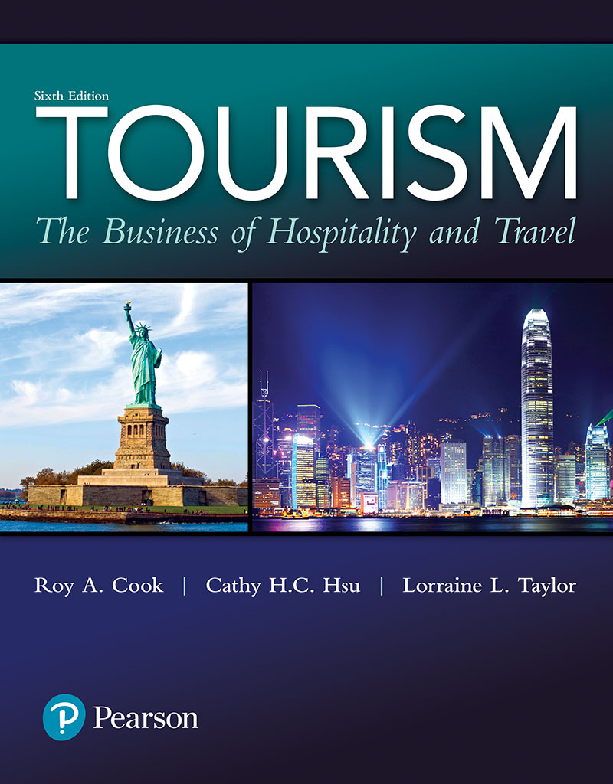
Tourism: The Business of Hospitality and Travel
Sixth Edition
Chapter 7
Accommodations

Slide 2
Learning Objectives (1 of 2)
Explain the importance of accommodations to the tourism industry
Identify and describe the major classifications of accommodations
Identify and describe the primary ownership patterns of lodging properties
Describe the basic organizational structures in lodging properties

Slide 3
Learning Objectives (2 of 2)
Describe the differences between front-of-the-house and back-of-the-house operations
Identify and describe key marketing, management, and financial considerations in lodging operations
Demonstrate knowledge of basic accommodation terminology

Slide 4
Brief History of Accommodations
Started as temporary stations on the way for travelers needing safe shelter for the night
Evolved into local gathering places for meetings and entertainment
Inns expanded in size and became hotels
Development of lodging facilities closely followed improvements in transportation
Notes:
Providing travelers with temporary shelter is an age-old profession that can be traced through recorded history to the inns of biblical times. In fact, the term hostel (meaning inn) can be traced back to the middle ages.
Early “hotels” were usually just overgrown inns. However, it didn’t take long for large structures specifically designed for lodging to appear. Most of these hotels were originally built in or around seaports and train depots as well as at major spa resort destinations in Canada, England, France, Germany, and the United States. In fact, development of lodging facilities closely followed improvements in transportation, particularly steamships and railroads

Slide 5
Oh, So Many Choices! (1 of 2)
Accommodations grouped under the umbrella term lodging
Many forms of transportation include "accommodations" as part of their service
Extensive range of accommodation alternatives
Attracting and retaining guests requires attention to their needs
Different brands within hotel chains
Notes:
Think for a minute about some of the accommodation options from which you can choose when planning a trip. Where will you spend the night(s) on the way to your des-tination? Where will you stay once you reach your destination? You can probably think of alternatives ranging all the way from staying with friends and relatives to pampering yourself at a luxury hotel.
Although accommodations can be found in many shapes and sizes, these facilities have commonly been grouped under the umbrella term lodging.
The accommodations segment of the tourism industry consists of many popular alternatives such as bed and breakfasts (B&B), condominiums, timeshares, conference centers, hotels, and motels, as well as recreational vehicle (RV) parks and campgrounds.
With so many choices, attracting and retaining guests requires attention to their needs
fine-tuning strategies to meet their specific needsWhich of the following statements is NOT true of a straight rental agreement?
A) All condominium owners share in rental income based on the square footage of their units.
B) Condo owners receive a portion of the rental revenues.
C) The owners typically pay for all taxes, utilities, and general maintenance expenses.
D) The owners receive a percentage of the rental income (usually 49%), and the management company retains the remainder (usually 51%).

Slide 6
Table 7.1 Strategies for Developing Loyal Guests
Notes:
As Table 7.1 illustrates, a broad array of strategies are needed to attract and retain a loyal following. In addition to targeting frequent stayers, marketers have recognized and developed varying brands within hotel chains to meet the needs of specific market segments

Slide 7
Table 7.2 Hotel Companies' Global Reach (1 of 3)
Notes:
In addition to targeting frequent stayers, marketers have recognized and developed varying brands within hotel chains to meet the needs of specific market segments

Slide 8
Table 7.2 Hotel Companies' Global Reach (2 of 3)

Slide 9
Table 7.2 Hotel Companies' Global Reach (3 of 3)

Slide 10
Oh So Many Choices! (2 of 2)
Bed and breakfasts (B&Bs): No two are exactly alike
Private accommodations: Living like a local
Time-share condominiums: Same time, same place?
Conference centers: Living, learning, and leisure
Campgrounds and RV parks: Enjoying the great outdoors
Notes:
The idea of B&Bs may have started in small towns and rural areas, but this con-cept has spread across the world and can be found anywhere someone wants to be his or her own boss.
Today, B&Bs come in a wide variety of sizes and service offerings. You can now find Bed & Breakfast Homes (1–3 rooms), Bed & Breakfast Inns (4–20 rooms), and Bed & Breakfast Hotels (over 20 rooms and sometimes a small restaurant).
Even though B&Bs may look different, personal attention and breakfast in the morning are common themes that tie all B&Bs together.
Why would travelers want to stay in someone else’s home? According to research, the primary reason is to “feel like a local” and get a taste of the community life during their visits.
Timeshares at condominium properties usually have the same amenities found in a typical luxury apartment setting. Condominiums (condos) and other types of accom-modations are often marketed as timeshares. The idea of owning timeshares (vacation or fractional ownerships), especially in resort locations, is very appealing to individu-als who can plan their travel activities in advance and want to be assured of accommo-dations at set times and in specific locations.
Historically, buying a timeshare unit (typically 1/52 or 1/26, one or two weeks) meant purchasing fixed weeks at a single-site location on a fee simple or right-to-use basis. This ownership assured the purchaser of having specific accommodations for a set time and place each year.
Timeshare companies now offer flexibility through mul-tisite programs, global exchanges, point systems, and vacation clubs.
Not surprisingly, the most popular locations for the millions of timeshare owners are in locations that are not subject to seasonality. In the United States, the most popu-lar timeshare properties are found at destinations such as Florida, California, Hawaii, Arizona, and Nevada.
Just as there are popular locations, there are also different times of the year that are more popular than others. These time periods are classified by colors indicating the level of demand.
Low-demand weeks are classified as “blue,” medium-demand “white,” and high-demand “red.”9 For example, a week during Christmas in Orlando, Florida, would probably be more desirable than a week in February in Okoboji, Iowa
A(n) ________ is a B & B concept that began in small towns and rural areas of Europe, where a family would open its home to travelers.
A) condominium
B) pension
C) motel
D) inn

Slide 11
Table 7.3 Excerpts from "Profile of Timeshare Owners"
Notes:
Timeshares are similar to hotels, but they are also different in many ways.
The num-ber of food and beverage options will definitely be more limited, but your accommodations almost always be larger and, you can prepare your own meals in a fully equipped kitchen.
While operational issues may be the same, timeshares unlike hotels and resorts are owned by many individu-als who typically purchase one or two weeks of vacation time.
Since owning a timeshare is a real estate investment, owners are required to pay insurance, maintenance fees, management fees, and real estate taxes. To attract and sell timeshare units require a great deal of marketing effort, and, in fact, 30–50% of the sales price for a timeshare is composed of marketing expenses such as salaries and enticements to attend sales presentations.
Timeshare ownership should not be looked at as a standard real estate investment that will grow in value, but more like an automobile purchase that will decrease in value over time.

Slide 12
Rooms, Rooms, and More (1 of 2)
Brief history of hotel development
Boston's Tremont House, 1829, the first hotel
Brown Palace in Denver, 1892, the first atrium
Statler Hotel, 1908, added many services and amenities
Notes:
- The next major change in the development of modern lodging occurred when Ells-worth M. Statler opened the Buffalo (New York) Statler Hotel in 1908. This hotel truly revolutionized the industry because it was designed and operated with guest com-fort, convenience, and safety in mind. Each room had an electric light just inside the doorway, a private bath with tub and toilet, and a pitcher of iced water

Slide 13
Rooms, Rooms, and More (2 of 2)
Brief history of hotel development
Great Depression, which began in 1929, resulted in 85 percent of hotels going bankrupt
End of WWII gave rise to new development but mainly in the form of motels
Recent decades a period of growth and high profits
Companies continue to add new brands of properties to better target specific segments, such as extended-stay travelers
Notes:
Based on the promise of providing standardized facilities, Holiday Inn soon grew into a successful chain of motels stretching across the United States. One room looked just like another and travelers always knew there would be free parking, a telephone, air conditioning, a swimming pool, and free ice. In addition, children under the age of 18 could stay free with their parents wherever they found the distinctive Holiday Inn sign.

Slide 14
Table 7.4 Profile of Extended-Stay Guests
Notes:
Recent decades have been marked by high periods of growth and profitability for the hotel industry. In addition, companies continue to add new brands of properties to better target specific segments, such as extended-stay travelers (see Table 7.4). As the consoli-dation and the brand boom continue, a handful of mega-operators dominated by Accor, Marriott International, Choice Hotels International, Hilton Hotels & Resorts, InterCon-tinental Hotels Group, and Starwood Hotels & Resorts Worldwide are emerging.

Slide 15
Making Sense of Classifications and Ratings Systems (1 of 2)
Organizations and governments have developed standardized classification and reporting systems to clarify the amenities and services at different types of lodging properties
Both consumers and hotel companies benefit from standardized classifications through clearly communicated expectations and brand positioning
Notes:
- A wide variety of lodging properties and amenities developed to meet the needs of spe-cific market segments. For example, business travelers expect to find larger desks, better lighting, casual seating, and irons and ironing boards in their rooms. As these features and other amenities such as shampoo, lotion, in-room coffee, and free newspapers became standard, travelers began to expect even more. As lodging properties race to meet customer needs, differences between traditional lodging property classifications such as hotels and motels have begun to blur.
To clarify this situation and more clearly communicate the differences in facilities and services among properties, organizations (and governments in some countries) developed standardized classification and report ing systems.
Both consumers and hotel companies benefit from standardized classifica-tions through clearly communicated expectations and brand positioning.1

Slide 16
Making Sense of Classifications and Ratings Systems (2 of 2)
Typical classifications
Limited-service budget motels
Limited-service economy motels
Full-service mid-priced hotels and motels
Full-service upscale hotels
Luxury hotels
All-suite hotels
Extended-stay hotels
Botique and lifestyle hotels
Notes:
1. Limited-service budget motels. Simple, basic, clean rooms with no amenities other than clean towels, linens, and soap. (Sleep Inns and Microtel)
2. Limited-service economy motels. Upgraded room decor with television, tele-phone, vending machines, and generally located close to restaurants. (Motel 6, Super 8, and Red Roof Inn)
3. Full-service, midpriced hotels and motels. 24-hour front desk, upgraded inte-rior and exterior decors, limited food service, extra room amenities, and other services. (Courtyard by Marriott, Four Points by Sheraton, and Holiday Inn)
4. Full-service, upscale hotels. Better quality and more luxurious, upgraded food service, and usually concierge service. (Delta Hotels, Hyatt Hotels, Hil-ton Hotels, and Westin Hotels)
5. Luxury hotels. Lavish guest rooms offering the ultimate in room amenities. Noted worldwide for service and surroundings. (Ritz-Carlton and Four Seasons Hotels)
6. All-suite hotels. Separate sleeping and living quarters, limited kitchen facili-ties, and complimentary food and/or beverage service in morning and evening. (Embassy Suites and MainStay Suites)
7. Extended-stay hotels. Apartment/studio living quarters targeting travelers seeking accommodations for five or more nights. (Residence Inn, Hyatt Sum-merfield Suites, Studio 6, and Staybridge Suites)
8. Botique and lifestyle hotels. Small to medium-sized hotels offering high lev-els of service with historic or innovative features. (Kimpton Hotels, Aloft, and Moxy Hotels)

Slide 17
Lodging Lexicon
Lodging has its own set of terms
Some terms are industry-wide, while others may be unique to certain companies
Notes:
- Some lodging terminology (see Table 7.5) is very specific and may sound almost like a foreign language the first time you hear it. For example, terms such as occu-pancy rates, average daily rates, RevPAR (revenue per available room), and RevPAC (revenue per available customer) carry specific meanings and are frequently used to measure financial performance and make comparisons among similar classifications of lodging properties.

Slide 18
Table 7.5 Hotel Terminology
Notes:
According to the accommodation terminology, a "double" is a “room with one double bed”

Slide 19
Figure 7.1 Room Layouts Demonstrating Lodging Terminology

Slide 20
Operating Structures
Five types of ownership/management are typical
Doing it alone: Small independent properties, managed by owners
Franchising
Management contracts
Chain operations
Strength in numbers: Referral associations
Notes:
The epitome of these independent hotels is referred to as a boutique hotel with unique architecture and décor, offering a high level of service and typically having fewer than 150 rooms.
Franchise agreements provide owners/operators (franchisees) with the use of a rec-ognized brand name, access to central reservation systems, training programs, docu-mented operating procedures, standardized computer software, quantity purchasing discounts, and technical assistance from the parent company (franchiser) in return for royalties and fees.
The idea of operating hotels under management contracts was born in the 1950s with the Caribe Hilton in San Juan, Puerto Rico. Management contracts, like franchises, allow lodging chains to expand aggre-sively into new markets without having to make capital investments in physical facilities. Under a management contract, hotel operating companies act as agents for the owner of the property. The owner of the property “hires” the operating company to fulfill all of the management and marketing functions needed to run the property. The property owner continues to retain all financial obligations for the property, and the management company is responsible for all operating issues. For their operating exper-tise, management companies receive a base fee anywhere from slightly under 3% to almost 6% of either total revenues or room revenues. In addition, other fees could be collected, including branding fees, sales and marketing fees, reservation fees, training fees, and incentive payments for achieving a predetermined level of profit. The con-tracts normally range from 5 to 20 years.
Group of properties that are affiliated with one another and have common ownership and/or management control and oversight are called “chain properties”.
Chain operations refer to groups of properties that are affiliated with one another and have common ownership and/or management control and oversight. Chain oper-ations can be created in a variety of different ways. For example, many chains such as Interstate Hotels & Resorts and John Q. Hammonds Hotels and Resorts have been developed using franchise agreements or management contracts. Chain operations provide many management, marketing, and financial ben-efits.
Can property owners retain operating autonomy and still reap some of the benefits that go along with franchise affiliations or chain ownership? This question may seem like asking for the best of both worlds, but the answer is yes. Membership in referral associations allows property owners to “go it alone” and still share the benefits that come from “strength in numbers.” Referral associations come in all sizes, meeting many different marketing needs. You may already be familiar with Best Western, but not Utell. Best Western claims more than 4,000 properties in over 80 countries;

Slide 21
Table 7.6 Franchise Requirements and Operating Fees
Notes:
Examples of franchise operating fees and requirements are shown in Table 7.6. In return for the benefits received from the franchiser and in addition to the required franchise fees, franchisees must give up some of their operational flexibility and follow standardized operating procedures (SOP) and purchasing requirements as outlined in the franchise contract.

Slide 22
It All Begins with Marketing
Sales and marketing efforts range from branding and reservation systems to individual staff
The ultimate goal of marketing efforts is to attract future bookings of individual and group business
Various methods to generate reservations including toll-free/Internet reservation system, travel agents, tour operators, convention and visitors' bureau, in-house sales staff
Notes:
other intermediaries such as tour opera-tors. For example, you might pick up the phone and call your hotel of choice directly or click on a website to book a room. Or you could stop in and see your travel agent who could use her GDS to reserve your room. If you were attending a large conven-tion, you might contact the convention and visitors bureau or a convention housing services firm to reserve your room

Slide 23
Table 7.7 Sources of Room Reservations
Notes:
Table 7.7 provides a list of many of the sources used by hotels to fill their rooms.

Slide 24
Providing a Home Away From Home
Lodging properties use a variety of service employees to fulfill guest needs
Employees are an important part of the sales and marketing efforts in lodging industry
Notes:
Lodging properties are more than just mortar, bricks, and sticks. Once the physical facility has been constructed, a staff must be hired, trained, organized, and motivated to meet guest needs. This task often begins long before reservations are made or guests arrive. Depending on the size of a property, guests may encounter a whole host of ser-vice employees.

Slide 25
Organizing for Success (1 of 2)
Basic operating functions
Administration (general management)
Guest contact services (front-of-the-house, such as front office)
Guest support services (back-of-the-house, such as engineering)
The number of employees performing these functions differ according to the size and complexity of the property
Notes:
Basic operating functions that must be performed in all properties include adminis-tration (general management), guest contact services (such as front office reception, cashiering, and housekeeping), and guest support services (such as groundskeeping, engineering, and maintenance)

Slide 26
Organizing for Success (2 of 2)
A general manager (GM) is the top manager with ultimate responsibility and an essential role in the success of a hotel
Larger properties have many middle managers in charge of functional areas
Larger and more complex properties often require personnel devoted to cost center functions such as marketing, accounting, human resource, maintenance, purchasing, and security
Notes:
No matter how large or small the property, the ultimate responsibility for property management remains with the General Manager (GM). GMs hold uniquely important positions, as they are the focal point for employees, guests, and the community.
As properties grow, the primary administrative and senior management duties for the revenue-producing activities of the hotel are typically divided between the front office manager, the director of food and beverage, and the director of house-keeping, who report to the general manager. It is also common in larger properties to find the front office manager and the executive housekeeper reporting to the direc-tor of rooms. These duties are further divided between front-of-the-house positions (guest contact services) and back-of-the-house positions (guest support services). F

Slide 27
Figure 7.2 A Typical Lodging Property Organizational Chart

Slide 28
Meeting Guests' Needs
The front office is the "heart" of lodging properties, acting as the first and last contact point and nerve/information center
Housekeeping is a critical support function, working closely with front office to assure cleanliness and maintenance of property
Notes:
- The front office serves as the “heart” of all lodging properties as well as the first and last point for guest contact. Front office operations are the nerve center and focal point of all guest activities and many employee contacts.
A key back-of-the-house guest service support group that is critical to guest satis-faction is housekeeping. In addition to ensuring the cleanliness of all guest facilities, the housekeeping department typically has the largest number of employees in a lodging property
Housekeeping must coordinate its activities very closely with the front office as it maintains the cleanliness and readiness of guest rooms, corridors, and common public areas in addition to managing laundry facilities in many properties.

Slide 29
Achieving Profitable Operations (1 of 2)
Occupancy rates and average daily rates are key to profitability
Break-even occupancy must be exceeded to make a profit
Profit margins tend to be thin due to capital and labor intensity
Notes:
- When the economy grows, the demand for overnight accommodations also tends to grow. This growth results in higher occupancy rates, attracting developers who build more proper-ties. This building boom finally slows when the economy softens, causing travel to slow or the supply of new rooms to exceed demand for these rooms. Therefore, construction and pricing decisions should be based on the ability to achieve and exceed break-even occupancy levels.
- If you were to walk in off the street on a high-demand day, you would probably receive the rack rate, the standard and most expensive quoted rate for one night’s lodging. However, due to the ease of travelers searching for information on the go, room rates are becoming more transparent. A guest could search the web or use an app to check the rate before walking in to the front desk. Therefore, often the best available rate (BAR) is offered to capture the walk-in guest through direct booking. The rack rate that is offered to transient guests is the most profitable rate for a pro

Slide 30
Table 7.8 Prosperity Point Hotel Revenues and Expenses for the Month of March 20xx (1 of 2)

Slide 31
Table 7.8 Prosperity Point Hotel Revenues and Expenses for the Month of March 20xx (2 of 2)

Slide 32
Achieving Profitable Operations (2 of 2)
Revenue management is now being used to maximize occupancy and room rates
The best available rate (BAR) is often offered to walk-in guests instead of the rack rate nowadays
Contract rates are the least profitable but provide guaranteed occupancy to hotels
Overbooking and walking guests are problems that can arise from revenue management
Notes:
If you were to walk in off the street on a high-demand day, you would probably receive the rack rate, the standard and most expensive quoted rate for one night’s lodging. However, due to the ease of travelers searching for information on the go, room rates are becoming more transparent. A guest could search the web or use an app to check the rate before walking in to the front desk. Therefore, often the best available rate (BAR) is offered to capture the walk-in guest through direct booking. The rack rate that is offered to transient guests is the most profitable rate for a pro
Other groups offered prices below rack rates are government employees and convention attendees. Government employees may be offered significant discounts because they frequently are limited in how much they can pay by their per diem rates. Conventioneers also receive reduced rates that have been negotiated based on the total volume of business the convention will bring to a property.
Failing to understand and adjust for these multiple variables can lead to the problem of overbooking. Even when manual systems are used, overbooking can occur

