Slide 1
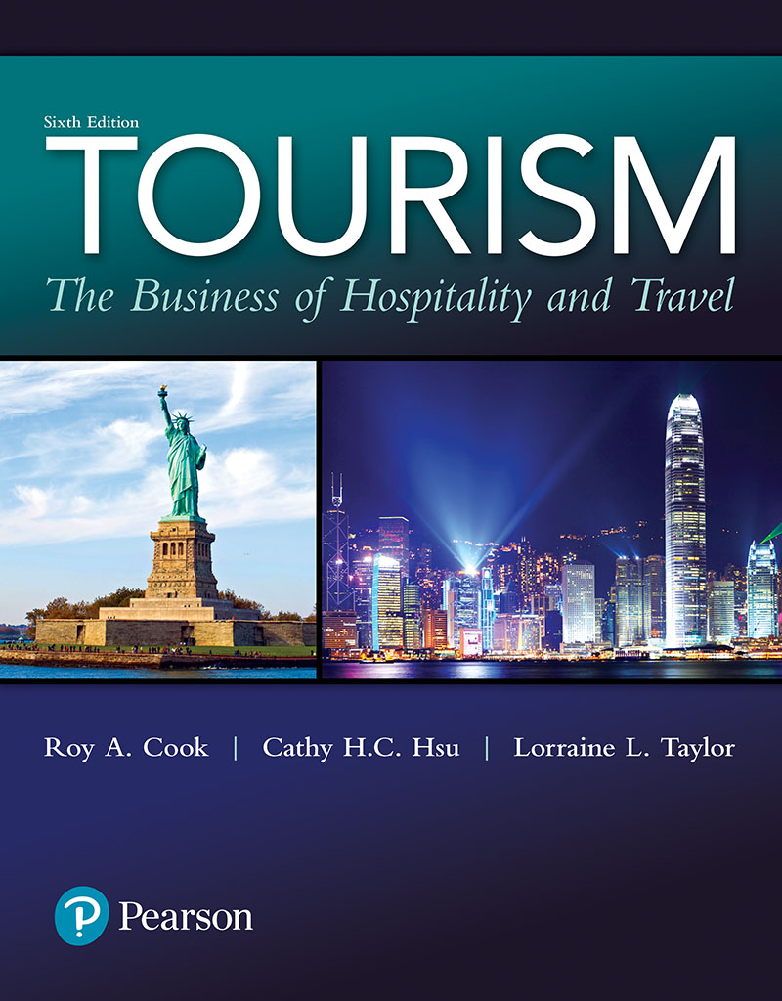
Tourism: The Business of Hospitality and Travel
Sixth Edition
Chapter 6
Transportation

Slide 2
Learning Objectives
Explain the importance of transportation to the tourism industry
Identify and describe the major components of the tourism transportation system
Explain the differences between passenger railroad operations within and outside the United States

Slide 3
Learning Objectives
Explain the importance of automobiles and motorcoaches to the tourism transportation system
Describe the role and importance of water transportation in the movement of travelers
Describe how airlines operate in a deregulated and competitive environment
Notes:
Traveling from Boston to New York? Your options are numerous!
- Luxury bus
Called the LimoLiner, this luxury bus costs about $178 round-trip, takes 4 hours, and features such amenities as reclining leather seats, free sandwiches, and movies.
- Bus: Greyhound offers round-trip express service for $70 with a trip time of about 4 hours and 20 minutes. Standard motorcoach amenities are offered.
- Train: Amtrak provides round-trip service for around $140, and the rail journey takes about 4 hours and 15 minutes. Seats offer more legroom and you can get up and walk around. Café cars sell snacks and drinks. No reservations are required. Just show up and buy a ticket.
- High-speed train Amtrak’s Acela is priced between $220 and $280 round-trip, and the special train shaves nearly an hour from the duration of the regular train’s trip. Amenities include extra legroom in comfy seats and power outlets for computers, phones, and DVD players. Foods offered are also a cut above its traditional counterpart.
- Airplane: Several airlines offer shuttles between cities. Advance-purchase tickets can often be had for about $120, whereas walk-up fares may be as high as $360. But the flight is short (about 1 hour). U.S. Airways even offers a special expedited security check so passengers can arrive just 20 minutes before take-off.

Slide 4
Transportation
Transportation modes can be conveniently classified into two broad categories:
surface (land and water)
air
Transportation is often intermodal, with travelers relying on several different modes of transportation to reach their final destinations
Notes:
the tourism industry would cease to function without an efficient and effective transportation system; trains, automobiles, and air-planes are just a few of the more obvious parts of this system.
There are many other modes of transportation in addition to planes, trains, and automobiles from which to choose. The components of this system can be conveniently classified and placed into two broad categories: surface (land and water) and air.
As Figure 6.1 shows, transportation is often intermodal, with travelers relying on several different modes of transportation to reach their final destinations
While the present pattern is for North Americans to use cars, Europeans to use trains, and Asians to use buses, expanding the options for ingress in and egress out of airports will be required to meet future demand.

Slide 5
Figure 6.1 Intermodal Transportation and Times
Notes:
- As Figure 6.1 shows, transportation is often intermodal, with travelers relying on several different modes of transportation to reach their final destinations.

Slide 6
Surface Transportation (1 of 2)
Plying the waves: History of water travel
Sailing vessels were at the mercy of the wind
Steamships allowed scheduled travel
Cruise ships
Importance of ferry service to certain regions
Notes:
The components of the transportation system can be conveniently classified into which of the following pairs of broad categories? surface and air
The jet engine heralded the demise of point-to-point ocean crossings.
water transportation, and most people think about cruise ships or a brief hop on a ferry when they cross a river, lake, or other short distance on a waterway. Water transportation, especially ferry services, is still an important link in the total transportation system.
Long-distance cruise ship cross-ings are typically restricted to repositioning cruises, in which cruise ships are being moved from one location to another. For example, a cruise line will move ships from the Caribbean to the Mediterranean to take advantage of seasonal changes and pas-senger demands. Cruise ships are such a significant sector of the tourism industry that we will take an in-depth look at cruising in Chapter 10
Passenger ferry routes have been designed to tie in with rail and road systems to facilitate intermodal transportation.
Technological advances in ferry design and construction have increased both speeds and operating efficiencies. These high-speed ferries are particularly noticeable in high-traffic tourist areas such as the Bahamas, Catalina Island, Hong Kong, Tas-mania, and along the Massachusetts coastline.

Slide 7
Surface Transportation (2 of 2)
Riding the rails: History of railroads
Developed in the 1800s, Europe
Importance of sleeping and lodging facilities in boosting long-distance rail travel
Passenger rail service in the U.S. and Canada began to decline in 1940s
Notes:
Passenger rail service had its origins in Europe. The first railway service for passengers was inaugurated in Europe on September 17, 1825, when the Stockton and Darlington Railway began offering regularly scheduled service in England. Passenger rail service arrived in North America in 1829, when the South Carolina and Canal Railroad began carrying passengers between Charleston, South Carolina, and Hamburg, Georgia, with steam-powered locomotives. Transcontinental service in the United States began in 1869 and in Canada in 1885.
Long-distance rail travel was given a boost in the United States when George Pullman developed the Pullman coach, with sleeping facilities for overnight travel.
Passenger rail service flourished and was an important form of domestic transpor-tation in Canada and the United States until the 1940s. In fact, railroad transportation was so prominent that lodging facilities were developed at major destinations along the rail lines such as Banff, Alberta, Canada, and White Sulphur Springs, West Virginia.
However, the forces of change eventually led to the decline of passenger rail service in North America. First, automobile ownership as well as the number of miles traveled by car increased. Then, the Trans-Canada Highway Act of 1949 and the U.S. Federal Aid Highway Act of 1956 enabled provinces and states to begin constructing major highway systems. Both of these factors facilitated long-distance automobile travel. Second, domestic jet passenger service became available. Third, the railroads did not adequately maintain their tracks or customer services. The final blow to U.S. passenger rail service came in 1967 when the post office announced that it would no longer ship mail by train. Without this government subsidy, passenger services became unprofit-able, and the railroads began to concentrate on moving freight.
Modes of transportation evolved slowly until the 19th and 20th centuries;

Slide 8
Table 6.2 Comparison of Travel Times between Washington, D.C., and Chicago, Illinois
Notes:
- Transportation has now become so efficient that we often think of travel in terms of time rather than distance

Slide 9
Canada and the United States Follow Similar Tracks for Rail Service (1 of 2)
Government intervention saved rail systems in U.S. (1971) and Canada (1978)
AMTRAK: Marketing name for National Railroad Passenger Corporation, the combination of U.S. passenger rail services
VIA Rail Canada: Marketing name for Canada's passenger train network
Both receive governmental financial support
Neither is a government agency
Notes:
Passenger rail service in the United States is provided through Amtrack.
Amtrak was formed in 1971 and VIA Rail Canada in 1978 to reduce the number of routes and points served while upgrading the remain-ing passenger rail systems.
Although in different countries, there are many similarities between these two passenger-rail-operating companies
Amtrak is the marketing name for the National Railroad Passenger Corpora-tion, which is a combination of the passenger rail services of U.S. railroads. Amtrak trains now serve 45 states, with stops in hundreds of communities.
VIA Rail Canada is the market-ing name for Canada’s passenger train network, which links over 400 communities throughout the country.
they are corporations structured and managed like other large businesses.

Slide 10
Canada and the United States Follow Similar Tracks for Rail Service (2 of 2)
AMTRAK and VIA Rail Canada Services
Marketing (especially packaging and rail passes) has increased ridership for both
Enhanced speed and service make travel time less by rail than air for some city pairs
Notes:
- Recent improvements in Amtrak service can be attributed to several factors: introduction of improved service and scheduling in the high-traffic Northeast cor-ridors, aggressive marketing and packaging of vacation trips including rail passes (All Aboard America Fares) and fly/rail packages, membership in the Airlines Reporting Corporation (ARC), and listings on airline computer reservation systems. Amtrak service has been further enhanced by the addition of high-speed trains (top speeds of 150 mph) on major passenger routes and routes that serve a feeders to major hub airports. In fact, in some city pairs, transit time is shorter via Amtrak service than by air service. Similar steps such as rail passes (CANRAILPASS), fly/drive packages, special tour packages, and lodging partnerships have been taken by VIA Rail Canada to enhance customer service and ridership

Slide 11
Asian and European Rail Service Blazes Ahead (1 of 2)
Rail travel is still a very important mode of intercity transportation in Europe and Asia
High-speed trains carry passengers between large population centers
Often rail travel is more popular than air travel
More convenient
Less expensive
Notes:
Although train travel has declined in Canada and the United States, it has continued to be an important mode of intercity transportation in Asia and Europe.
Between major population centers within European countries, train travel has also become so fast and efficient that it is often more convenient and less expensive than travel by plane when travel to the airport, check-in, and baggage handling times are considered.
The technology for high-speed rail travel is continually evolving, and trains that can travel at speeds of up to 270 miles per hour are being put into service.4
The popularity of high-speed rail in Taiwan has actually caused the bankruptcy of several domestic airlines; and the surviving airlines no longer offer routes that duplicate the service of the rail

Slide 12
Table 6.3 Comparison of Train and Air Travel Times between Key European Cities
Notes:
Transportation has become so efficient that we often think of travel in terms of time rather than distance.
rail service in Canada and the United States is more expensive and very difficult to piece together for long distance journeys.
Examples in Table 6.3 compare the competitive nature of train and air travel between key European cities.
Between major population centers within European countries, train travel has also become so fast and efficient that it is often more convenient and less expensive than travel by plane when travel to the airport, check-in, and baggage handling times are considered.5
By comparison rail service in Canada and the United States is more expensive and very difficult to piece together for long distance journeys
The development of high speed rail service is associated with all of the following EXCEPT? increased rail traffic from freight shipments

Slide 13
Asian and European Rail Service Blazes Ahead (2 of 2)
The Eurailpass attracts non-European international travelers
Trend toward privatizing government-owned rail systems
Notes:
Passenger rail service in Europe has been further enhanced through expansion of the Eurailpass
The Eurailpass is used as a marketing tool to attract international visitors from
outside the European community because it is available only to non-European tourists.
A number of European countries—Austria, Belgium, Denmark, France, West Germany, Italy, Luxembourg, the Netherlands, Norway, Portugal, Spain, Sweden, and Switzerland—introduced the first Eurailpass in 1959. Finland, Greece, and Ireland were added later. With the fall of the Berlin Wall and the end of the Cold War, the pass became valid throughout the entire German Republic as well as the Czech Republic and Hungary.
Trains have become so significant in Europe that they move more than 40 times more passengers every day than in the United States.
Passenger rail service in Europe has been further enhanced through expansion of the Eurailpass. A number of European countries—Austria, Belgium, Denmark, France, West Germany, Italy, Luxembourg, the Netherlands, Norway, Portugal, Spain, Sweden, and Switzerland—introduced the first Eurailpass in 1959. Finland, Greece, and Ireland were added later. With the fall of the Berlin Wall and the end of the Cold War, the pass became valid throughout the entire German Republic as well as the Czech Republic and Hungary. Trains have become so significant in Europe that they move more than 40 times more passengers every day than in the United States

Slide 14
Cruising the Highways and Byways
The French and English innovated the road construction
Development in road systems increased auto travel
Automobiles
Motorcoaches

Slide 15
Automobiles (1 of 2)
Reasons for preference:
Cost
Convenience
Ability to explore/change route
U.S. and Canada have funded highways instead of rail tracks
Notes:
The availability of affordable automobiles and an expansive highway system have made automobile travel the most popular form of transportation in Canada and the United States.
The vast majority of domestic trips in the United States were taken over the highways.
Both Canada and the United States have focused government attention and resources on the development of highway systems rather than rail systems.
The interstate highway system in the United States has resulted in an intricate web of 42,800 miles of divided highways connecting every major city in the country. This system is truly remarkable because it accounts for only 1% of all roads in the United States but carries over 20% of all highway traffic.

Slide 16
Automobiles (2 of 2)
Growth in rental car market
Dominated by business travelers but there is growth in the leisure market
Fleet utilization and logistics are important to success
Notes:
- Enterprise (with the acquisition of Vanguard, the parent company of Alamo and National) has the largest rental car fleet, followed by Hertz, and the combination of Avis and Budget into the Avis Budget Group, respectively. The primary users of rental cars are business travelers, who rent over 75% of all vehicles, but car rental companies are beginning to turn some of their attention to leisure travelers. Hertz and Enterprise serve to highlight the differences in marketing strategies among the rental car companies. Hertz controls the largest market share at most major airports whereas Enterprise has chosen to service a broader range of customers by delivering cars directly to customers from less expensive off-airport sites
- The range of variables managers must deal with in this industry is staggering. To deploy fleets of cars ranging in average age from 8 to 12 months across broad geographic areas and achieve maximum fleet utilization, managers must anticipate a wide variety of customer demands, including car types, rental periods, insurance, fuel options, and pickup and return locations. Like other tourism service suppliers, rental car companies have a slim profit margin. For example, “the profit margin on a $50 rental is around $5” (p. 1).10
Just think about what happens to that margin if a renter brings the car back with less than a full tank of gas and pays the often unobserved and inflated price charged for refueling
- Logistics also play a key role in successful car rental operations in getting the right cars to the right place at the right time. Recent software developments provide the nec-essary information for employees and managers to know when to refuse a short-term rental based on the probability that the same vehicle can be rented for a longer term to a different customer.7

Slide 17
Table 6.6 Growth in Major Business and Leisure Rental Car Suppliers in the United States (2010-2015)
Notes:
Cars must be moved to meet seasonal demand, creating inexpensive repositioning rentals as fleets must be moved from high demand area.
Can economies of scale make a difference? The answer is yes, as demonstrated by the dominance of Enterprise and the Avis Budget Group in the business and leisure markets shown in Table 6.6.
price is important, but it is often the lit-tle things, such as how quickly you get your car, that make a difference
Car rental companies are responding to these requests by enhancing their services to include valet delivery and parking services to avoid shuttle buses, equipping cars with onboard computerized navigation systems, providing drop boxes for the return of keys and rental forms, and equipping service personnel with handheld computers to com-plete rental transactions at the point of return.

Slide 18
Motorcoaches
Intercity bus travel has declined until recent years, while group motorcoach travel has increased
New designs have increased comfort, services available, and capacity
Notes:
Currently two primary categories of motor coach (often called bus) transportation—1. scheduled intercity travel and 2. charter/tour groups.
Intercity bus travel continues to decline
upgrades at Grey-hound and a variety of start-up carriers serving paired cities like New York–Washington, D.C., Los Angeles–San Francisco, and Chicago–Milwaukee. Using concepts such as yield management and hub-and-spoke systems, bus companies are finding new niches and growth opportunitie
“Seats are wider. Views are better. There’s stereo music and often an integrated video sys-tem showing the latest movies, just like the airlines.
In southern European countries, including Portugal, Greece, Spain, and Turkey, bus service may be faster but more expensive than trains.19The long-distance bus networks of Great Britain, Ireland,Portugal, Morocco, Greece, Turkey, and the Czech Republic are more extensive, more efficient, and often more comfortable than trains. The Eurobus programs provide direct competition to train-pass programs, with two months of unlimited travel on bus
In most major tourism active metropolitan areas, such as Paris, London, Sydney, and Shanghai, city tour buses are available to take visitors around major tourist attrac-tions within the city. Passengers can purchase a single day or multi-day pass and “hop on, hop off” as often as they wish. These bus tours are often known as loop tours; because the buses drive around town in a loop, provide a quick and convenient way to get an overview of a city.

Slide 19
Soaring Through the Skies (1 of 2)
Air travel is a 20th century mode of travel: Jet travel only in second half of century
Cooperative organizations make the industry more efficient
ATA (Air Transport Association): U.S. domestic airline alliance
IATA (International Air Transport Association): International alliance
Notes:
These programs have increased customer loyalty, with passengers often going out of their way or taking inconvenient flights to obtain frequent-flier miles, yet few actu-ally cash in their mileage for awards. Airlines are also partnering with a multitude of other organizations both inside and outside the tourism industry by offering miles for purchase to generate additional revenues, increase brand awareness, and heighten customer loyalty.
The purpose of IATA is to facilitate the movement of passengers and freight across a combination of route structures and international boundaries.
Airlines, like most other service providers in the tourism industry, operate on very thin profit margins. In fact, since the inception of commercial air service, airlines have collectively lost more money than they have ever made. Therefore, controlling costs and maximizing revenues are major concerns and absolute necessities for survival and profitability.

Slide 20
Soaring Through the Skies (2 of 2)
Cooperative organizations make the industry more efficient
These associations make it possible for passengers to purchase a single ticket although they may travel on planes owned and operated by several companies in a single trip

Slide 21
Figure 6.3 Domestic and International U.S. Airline Industry Share of Operating Expense
Notes:
- Salary and benefits are the factors figures as the highest share of operating expense in the domestic and international U.S. airline industry

Slide 22
Operating in a Deregulated Environment (1 of 2)
Airline travel was deregulated in U.S. in 1978
Changes due to deregulation:
Competition on price
Increase in number of airlines serving any city
Airlines enter and leave airport service at will
Airlines can package and market tours as tour operators
Notes:
- Deregulation removed all the previously listed operating constraints that restricted airline operations. Pricing became very complex. Rather than a simple three-tier structure (economy, business, and first class), there are multiple prices, and airlines change these prices hundreds of thousands of times each day. Sometimes, very low prices on a particular route may be available for only a few minutes. All these changes are being made as airlines attempt to meet customer needs, maximize load factors, and increase revenues through their revenue management systems. Today, there is little to keep a carrier from entering a new city other than airport safety and capacity constraints.
Airlines may now function as tour operators, providing packaged tours directly to the public. In addition, they may own and operate travel agencies, and they may develop new methods of selling tickets other than directly and through the existing travel agency system. This latter change has resulted in satellite ticketing terminals that operate in a manner similar to automatic teller machines and other forms of electronic access, including ticketless travel.
Air routes were made available to all carriers who could meet safety and service standards, and new carriers were encour-aged to provide a variety of low-priced services.The Federal Aviation Administration (FAA) has responsibility for the safety of air transportation carriers.

Slide 23
Operating in a Deregulated Environment (2 of 2)
Hub-and-Spoke system reduces cost of operation and increases load factors
Use of code-sharing agreements link regional carriers to national lines
New smaller, regional jets (RJs) are being tried to increase direct flights
Notes:
- Deregulation made the hub-and-spoke system the primary route pattern for leg-acy carriers throughout the world. Airlines select hubs near major metropolitan areas, where passenger, administrative, and maintenance activities can be concentrated and quickly rerouted to their final destinations. By designating primary hubs, airlines are able to funnel traffic into these centers to feed their trunk routes from smaller markets along spoke routes. This system allows the airlines to capitalize on economies of scale and match the size of the aircraft serving a market to the demand from that market. An example of a hub-and-spoke system is shown on the map in Figure 6.4.
Regional/commuter airlines, which provide lift to the legacy carriers’ hubs by flying shorter domestic passengers on spoke routes, typically operate on a code-share basis. Regional/commuter airlines, which fly domestic passengers on spoke routes, typically operate on a code share basis. In a code-share agreement, a regional/commuter airline does not sell its own tickets, but shares the same two-letter identification code of a major airline in the computer reservation system and usually paints its planes the same color. The term code refers to the flight number that is used in flight schedules. Under a code-sharing agreement, participating airlines can present a common flight number for connecting flights.
Cooperating airlines also strive to synchronize their schedules, to maximize passenger transfers between connecting flights, and consolidate the cost of both airlines’ flying the same route. Code sharing allows carriers who do not operate their own aircraft on a given route to gain exposure in the market through display of their flight numbers and the ability to offer those routes to their customer base
The hub-and-spoke system is used primarily by legacy carriers. In theory, by utilizing the hub-and-spoke system, legacy carriers such as American and United are able to increase operating efficiency through scheduling arrivals and departures in banks of flights. Banking flights is the process of coordinating flight schedules to maximize the use of ground crews and equipment as waves of flights are scheduled to arrive and depart at very close to the same time. In addition, the shorter the period of time that an aircraft remains on the ground, the more time it can spend in the air earning money. Some regional/commuter airlines are able to turn their aircraft around or push them in 15 minutes or less, whereas major carriers may take as long as 45 minutes to do the same tasks.

Slide 24
Figure 6.4 Hub-and-Spoke System

Slide 25
Decoding the Language of the Airline World
Each airline has a two-letter identification code
Each city with scheduled air service has three-letter code
Classes of service have codes
Types of flights have special names, e.g., direct, non-stop, etc.
Passenger trip type are given special terms, e.g., round-trip, open-jaw
Notes:
The term code refers to the flight number that is used in flight schedule
Airline service is also classified as nonstop, direct or through, and connect-ing. Nonstop flights are from the point of origin to a destination with no intermediate stops. Direct or through flights are from the point of origin to a destination with one or more intermediate stops. Connecting flights require passengers to change planes to a connecting flight between the point of origin and final destination.
There are also several types of trips that passengers can book. Examples: one-way—a trip from origin to destination without a return to origin; round-trip—a trip from origin to destination with a return to origin; circle-trip—similar to a round-trip except that the outbound and the return trips follow different routes and possibly use different airlines; open-jaw—a round-trip that allows the passenger to utilize different points of origin or return.
All of the following designations are used to classify airline trips EXCEPT business.

