Slide 1
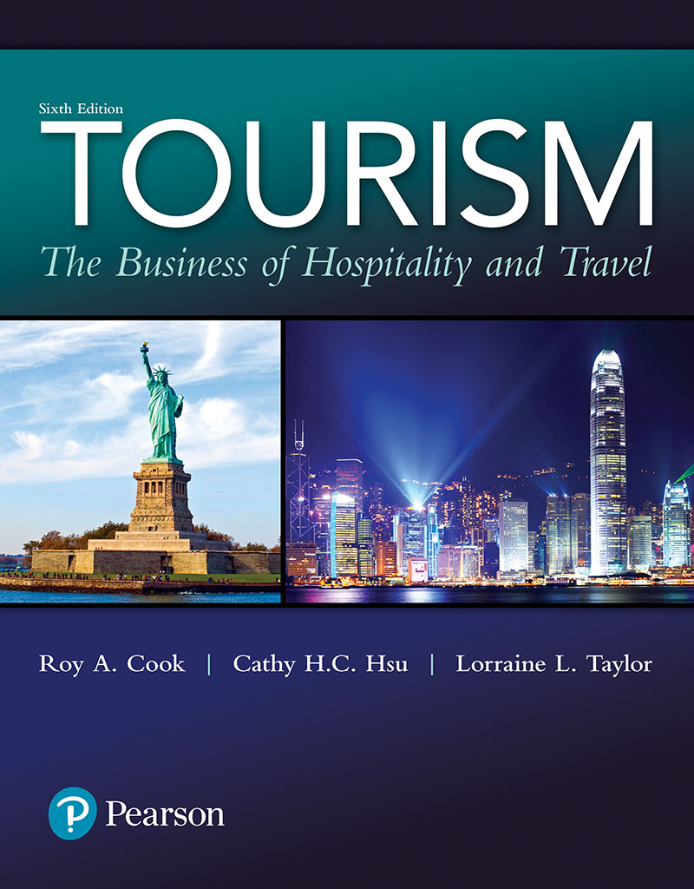
Tourism: The Business of Hospitality and Travel
Sixth Edition
Chapter 5
Capturing Technology’s Competitive Advantages

Slide 2
Learning Objectives (1 of 3)
Describe some of the technological trends that are shaping operating practices of tourism service suppliers
Describe how technology can enhance productivity
Describe how technology can improve both internal and external communications

Slide 3
Learning Objectives (2 of 3)
Describe how technological changes will have an impact on the future of the tourism industry
Describe how technology can enhance customer service

Slide 4
Learning Objectives (3 of 3)
Describe how the Internet has changed tourism operations
Describe how revenue management has improved the financial performance of tourism service suppliers
Notes:
How do travel service companies stay on the cutting edge of technology? Technological innovation and customer service have been the answers for Wyndham Jade (wyn-dhamjade.com), a leader in travel services.
What you just created is called a “data warehouse”. So what you describe is called a “data warehouse”. One column is called a “data field”. If you run up enough the data, eventually you can find good information. That is called “data mining”. So analyzing the data warehouse is called data mining.
Harrah’s is the example often used in the hospitality industry. They are the first hospitality industry to do data mining. In 1997, Harrah’s hotels and casinos introduced a trademarked loyalty-card program, “Total Rewards,”. This program tracks customers’ purchasing activities and provides rewards that encourage spending at Harrah’s properties. They used an information system called WiNet to link all its properties. This information system allows the firm to collect and share customer information company wide. The WINet system connects and consolidates customer information from all of the company’s transaction, slot-machine, hotel-management, and reservation systems. Key information, such as gender, age, place of residence, and types of casino games played, helped predict which customers are most likely to become frequent users. Why? Knowing their guests in terms of where they are from, how much they spend money, and when and what they spend it helps managers formulate marketing strategies, enhance guest experience, increase retention and loyalty and ultimately, maximize profits. So, based on this information, Harrah’s designs marketing strategies to retain profitable customers. Customers’ purchasing and gaming patterns are tracked, too, so that the company can target its customers with the most-appropriate incentives. For example, customers who reside outside the local area receive complimentary hotel rooms or transportation, while drive-in customers receive food, entertainment, or cash incentives. During the first two years of its rewards program, Harrah’s saw a $100-million increase in revenue from the customers who visited more than one property.
Harrah’s casinos would find their transition to gamble using data mining.

Slide 5
Technology (1 of 2)
Definition
Use of new knowledge and tools to improve productivity and systems
Creates both challenges and opportunities for tourism service providers
Inexpensive data storage and processing speeds have given rise to POS and ERPs
Notes:
How do travel service companies stay on the cutting edge of technology?
The tourism industry is constantly innovating to anticipate and meet customer needs.
Organizations from around the world utilize Wyndham Jade’s convention plan-ners to recommend destinations, handle negotiations, organize travel and hotel requirements, and provide a wide range of on-site support services. For large national and international meetings and conventions, Wyndham Jade offers an extensive suite of convention housing and registration services and reporting management services. Meeting attendees and exhibitors are able to register, book hotel reservations, and make travel arrangements all at the same time online via the Web . . . 24 hours a day . . . from anywhere in the world. These services are enhanced through a variety of proprietary software products that have been designed to provide rapid and flexible customer interface and management reporting for any type of event large or small.
Corporate travel clients receive 24-hour full-service personalized travel agency ser-vices combined with travel management analysis and reporting. These services result in significant cost savings while at the same time allowing travelers to take advantage of corporate discounts and loyalty programs. In-house technology development and support programs have allowed Wyndham Jade to remain competitive with Internet vendors while adding the all-important human touch desired by the most demand-ing corporate travel management clients. This same level of service has recently been extended to a new market segment, athletics, through Jade Sports. Incentive and meeting services clients have come to expect turnkey support from concept development to program fulfillment in a variety of performance enhancement
Technology, which we broadly define as the use of new knowledge and tools to improve productivity and systems, has created both challenges and opportunities for tourism service providers.
As data storage capacities expand, processing speeds seem to grow exponentially, all at lower and lower costs, permitting the power of information technology to be within the reach of almost every organization. The same technology that is driving the information revolution has spawned other innovative uses from point-of-sale (POS) systems to enterprise resource planning (ERP) systems
we will explore the challenges posed by technological advances and innovations as well as the benefits being derived as they are adopted by tourism service suppliers, both large and small

Slide 6
Technology (2 of 2)
Outcomes from investments in technology
Enhanced productivity
Improved communications
Enhanced customer service
Improved profitability
Competitive advantage

Slide 7
Figure 5.1 Technology's Impact on Tourism Service Suppliers

Slide 8
Improving Operating Efficiency and Effectiveness
Rising wages, increasing input costs, and intensifying competition necessitated changing of old ways
Examples of technology improvements
Staffing programs match staff levels to demand levels
Communication technology (such as remote devices) makes internal ordering and inventory stocking more efficient
Notes:
In the face of rising wages, increasing input costs, and intensifying competition, tour-ism service suppliers have been forced to make cuts in staff size, increase productivity, and rethink marketing efforts
Staffing software allows supervisors to schedule employees in key time slots to meet peak customer demands while limiting coverage during slack times.
In hotels, dining room and housekeeping employees can transmit orders, rooms’ status, and inventory needs through wireless headsets and handheld order-entry equipment.
Many other technological innovations have evolved as tourism service suppliers search for solutions to enhance customer service, respond to operational demands, and improve profitability.

Slide 9
Management Information Systems (1 of 2)
Computer-based systems for collecting, storing and retrieving information for planning, decision-making and problem-solving
Point of data input
Reservations
POS device
When guests check in
Notes:
Management information systems (MIS) or information systems provide the backbone for operational decisions. They are computer-based systems designed to collect and store data and then provide information for planning, decision making, and problem solving.
Most of the information management functions for the airlines and other transportation ser-vice providers were centralized for operational efficiencies and profit improvement.
Airlines pioneered the development of centralized MIS
Many other MIS for other tourism service suppliers were initially implemented
Radio frequency identification devices (RFIDs) are being used to control hotel guest room locks, to track inventory, and for a variety of other uses for which low-cost tracking and security are needed

Slide 10
Management Information Systems (2 of 2)
Aid property- and store-level decision making
Aggregation of data can improve financial, management and marketing decisions
Enterprise Resource Planning (ERP) System is the total integration of all information sources
Point-of-sale system for foodservice
Property management system for hotels and resorts
Notes:
reservations management systems, back office accounting systems, and human resource management systems have been in use for years. Today, lodging companies have centralized these programs, moving them from individual properties to corporate offices. This allows software updates to be made once, instead of at various times in locations, that may be spread around the world.
POS systems for restaurants, with intuitive touch screens, reduce training time for servers and cashiers, reduce input errors and waste, and improve customer service
Touch screen and wireless systems are quickly becoming the standard
Consolidated data accumulated by a chain or a POS provider are available via an Internet site
Databases create powerful tools for making improved marketing, management, and financial decisions as reports can be generated by the day, hour, and minute
Point-of-Sale (POS) systems are being integrated into MIS to improve foodservice efficiency and profitability at a staggering pace
• Process reservations, • Manage wait lists, • Balance table assignments, • Record and track customer orders, • Process debit and credit cards, • Reduce credit card expenses, • Manage inventory
PMSs combine computer hardware and software into an integrated information system. These sys-tems provide a central point for accumulated data and integrate a variety of activities at the property level such as:
Reservations (Internet, central reservation, and GDS reservations), • Pricing and revenue management, • Guest profile, • Guest check in and check out, • Electronic keys, • Telephone, messaging, and television activation, • Maintaining guest folios (revenue recognition), • Updating room status and housekeeping data, • Combining night audit information and reports, • Maintaining employee payroll records, • Updating inventory records, • Creating financial statements, • Tracking travel agency bookings and commissions, and • Tracking the effectiveness of marketing programs

Slide 11
Table 5.1 Examples of Management Information System Features
Notes:
- Table 5.1 provides just a few examples of the many individual tasks that can be accomplished with integrated data retrieval and analysis programs.

Slide 12
Providing Customer Convenience and Enhancing Service
Do-it-yourself approach via self-service kiosks
Handheld devices and tablet computers aid employees in the service delivery process
Geo-based technology helps identify unique features of the current place
Database marketing/data mining aids in targeting microsegments with customized marketing mixes
Notes:
Technology has reduced labor costs for operators, but ultimately customer service has improved.
Consumers are more informed of the tourism products and more engaged in travel-related activities so as to enhance their consumption experience
Many quick service restaurants have installed touch screen kiosks at busy stores to allow customers to place their own orders. Casual dining restaurants have also placed ordering device on the table for diners to make order themselves. Many tourist attractions offer audio or video “tour guides” so that visitors can have an informed visit at their own pace.
Geo-based technology, such as car navigation systems, geo-based software and applications on personal computers or mobile technology, location-based portable recommender systems, and/or GPS-based devices for outdoor activities,
Database marketing, based on data mining, is aiding tourism suppliers in targeting microsegments of their markets and customizing marketing mixes to fulfill the needs of specific travelers. Because of seemingly endless capacity of cloud-based storage marketers can access and rapidly sift through vast amounts of information, allowing them to build immense databases providing extremely detailed profiles of prospective consumers. Information in the database could come from a variety of sources, including customer provided information upon reservation or joining frequent guest program, employee observation, consumption record, guest complaint, and customer survey.

Slide 13
Changing Communication and Distribution Channels
Advent of the Internet fundamentally changed all distribution channels
Online booking engines allow travelers to compare schedules and prices without an intermediary
The early airline reservation systems have later been further developed and evolved into the Global Distribution System (GDS)
Notes:
The early airline reservation systems have later been further developed and evolved into what we know today as the Global Distribution System (GDS). GDS now not only allows travel intermediaries to make reservations for hotels, resorts, car rental, railways, cruise lines, and other tourism products, but also provides other integrated marketing services and information.
Internet access has become ubiquitous Smart phones are overtaking personal computers as the dominant platform to access the Internet
The six major GDS (i.e., Amadeus, Sabre, Abacus, Apollo, Galileo, and Worldspan) owned by three major GDS companies (i.e., Amadeus, Sabre, and Travelport) process more than 2,000 transactions per minute.
They distribute products for more than 550 airlines, over 90,000 hotels, the world’s largest car rental companies, hundreds of tour operators, and the major cruise lines to travel agencies. GDS generates about two-thirds of all airline passenger revenue, over 10% of hotel room revenue, and about 30% of car rental revenues in the United States

Slide 14
Table 5.3 Internet Usage Around the World
Notes:
Take a look at Table 5.3 to see the phenomenal growth, penetration, and usage of the Internet
By 2015, over 3.2 billion Internet users and 7 billion mobile subscriptions were reported.
This represents an astounding growth rate of 960% and 660%, respectively, for these forms of digital connec-tivity from 2000. Market penetration rates of 43% for Internet usage and 97% for mobile availability bode well for electronic connectivity between consumers and tourism suppliers.7

Slide 15
Internet-Based Distribution for Hotels
Hotels use central reservation systems (CRSs) to make room bookings
Lodging marketing organizations or trade associations
Online travel agencies
Distribution channel
Information source providing customer reviews and comments
Notes:
- Hotels, especially chain hotels, have been using central reservation systems (CRSs) to make room bookings. Large hotel corporations usually use proprietary CRS, whereas smaller hotel chains or independent hotels could use commercially available reservation software. CRSs are internal systems shared by member hotels. Holiday Inns launched the first hotel CRS, Holidex, in 1965 to enhance the efficiency and cost-effectiveness of lodging product distribution. The modern CRS is integrated into the overall enterprise systems and provides customer profile, preferences, and behavior information for data mining. The reservation functions on hotel websites are part of the CRS. CRS facilitates direct distribution, and at the same time are connected to GDS to make the three-level distribution more efficient.
CRS is integrated into the overall enterprise systems and provides customer profile, preferences, and behavior information for data mining
Large hotel corporations usually use proprietary CRS, whereas smaller hotel chains or independent hotels could use commercially available reservation software. CRSs are internal systems shared by member
Holiday Inns launched the first hotel CRS, Holidex, in 1965 to enhance the efficiency and cost-effectiveness of lodging product distribution.
One research study showed that online travel agencies (OTAs) serve not only as a distribution channel for selling hotel rooms but also as an information source providing customer reviews and comments on their platform

Slide 16
Internet as a Travel Tool
Travelers use Internet for ideas, inspiration and information
Web uses
Source of customized maps
Up-to-the-minute weather
Status of flights, etc.
Replacement for guidebooks as source of destination info
Stay in contact throughout trip
Notes:
Internet and travel product distribution
Travelers use Internet for ideas, inspiration and information
Web uses
a. Source of customized maps
b. Up-to-the-minute weather
c. Status of flights, etc.
d. Replacement for guidebooks as source of destination info
e. E-mail contact throughout trip

Slide 17
The Power of User-Generated Content
User-generated content facilitated through social networking and blogging
One traveler speaking to another
Both positive and negative comments communicated
Managing brand presence on social networking sites
A growing and important source for online travel information searches
Notes:
User-generated content, made possible through Web 2.0 and facilitated through social net-working and We(b) logs, blogs (Facebook, YouTube, LinkedIn, WeChat, and other social media platforms), found its way into the world of tourism and hospitality and is having a profound impact on the entire tourism industry.
The Power of User-Generated Content
Social networking and blogging - one traveler speaking to another
Social media is not only allowing consumers to research tourism sites and book services, but they can also create content and engage with companies
Both positive and negative comments communicated
Organizations must now monitor what is being said and distributed about them
Many tourism suppliers and online travel agencies are actively managing their brand presence on social networking sites by connecting with consumers
When information is acquired and analyzed from every customer touch point, meaningful relationships can be formed with customers from the information collected

Slide 18
Improving Profitability
Revenue management: Method of allocating service capacity, originated by airlines
Now applied in many industries that can improve revenues through its use
Notes:
Improving Profitability
A. Revenue management (which is also called yield management), a foundational component of almost every MIS for tourism service suppliers
B. Revenue management: Method of allocating service capacity, originated by airlines
C. Now applied in many industries that can improve revenues through its use
Revenue management (which is also called yield management), a foundational compo-nent of almost every MIS for tourism service suppliers, was developed by Bell Labora-tories in 1988 and initially used as a scheduling tool for the airline industry. However, its effectiveness in addressing a host of marketing, management, and financial issues soon expanded its use to other tourism service providers such as hotels/motels, resorts, restaurants, theme parks, cruise ships, golf courses, and car rental companies. Basi-cally, revenue management requires allocating capacity to customers at the right price and at the right time to maximize revenue or yield, enhance customer service, improve operating efficiency, and increase profitability under the following conditions.
A student asked the inputs/elements in Revenue Management (RM) and definition of RM from my perspective.
Here is my response:
- My view of RM from a system/process perspective. That is, I tend to follow the common general steps of a RM
system. Generally speaking it includes: Generating "Forecasts" - >Applying "Controls" ->"Monitoring".
- Each of these steps is broken into several elements. For example, in the forecasting phase, you would consider the data input (which has several aspects including type and sources) and the generations of forecasts (demand and probability; also known as demand prediction with some % of confidence). The controls includes the application of the optimization algorithm for price and allocation recommendation, subjective evalution of these systems or algorithmic recomendation by decision makers (revenue/sales managers: set price, allocate units to distribution channels at certain price) and application of the controls to the various channels/merket segments such as minimum lengh of stay, availability
of rates, overbooking, bundling (packaging), product differentiation, etc. And so on for the monitroing and feeback phase (testing whether the control was sucessful; whether the forecast was accurate; whether the controls were effective).
As for my definition of RM. I prefer the one that refers to the collection of pricing and allocation of units policies
(also known as the controls) designed to optimize profits (through revenue optimization) in service firms with
perishable products.

Slide 19
Conditions for Revenue Management
When capacity is relatively fixed
When demand can be separated into distinct market segments
When inventory is perishable
When services can be sold well in advance
When demand fluctuates substantially
When marginal sales costs are low and marginal capacity costs are high
Notes:
When capacity is relatively fixed. For example, when demand increases, airlines cannot simply add more seats; hotels cannot add more rooms; and rental car com-panies cannot quickly enlarge fleets at specific locations.
• When demand can be separated into distinct market segments. For example, tourism service providers can segment demand based on specific customer profiles and needs.
• When inventory is perishable. For example, as we have previously mentioned, once a plane has left the gate, there are no more opportunities to fill its seats with revenue-paying passengers on that flight.
• When services can be sold well in advance. For example, reservation systems allow leisure travelers to save money by making advance reservations with specific time restrictions.
• When demand fluctuates substantially. For example, during periods of high demand, higher rates can be obtained, but during periods of lower demand, lower rates may be necessary to attract customers.
• When marginal sales costs are low and marginal capacity costs are high. For example, the cost of selling an additional reservation for an airplane seat or a night’s lodging is minimal, but the cost of purchasing a larger airplane or adding rooms to an existing hotel would be very expensive
Although revenue management has been widely applied in many different industries, each of these industries has their own specific characteristics and differences

Slide 20
Strategic Levers Unique To Services
Revenue management has been widely applied in many different industries
Each industry has specific characteristics and differences
Two strategic levers unique to services
Price: fixed (one price for all) or variable (dynamic pricing)
Consumption duration: predictable or not

Slide 21
Operational Considerations
Factors to be considered: desired market position, customer satisfaction, employee morale, and demand for related goods or services
Additional benefits from revenue management when it is combined with dynamic packaging and suggestive selling
Notes:
Operational Considerations
1. Must consider factors such as market position, customer satisfaction, and demand for related services when using yield management
2. Additional benefits can be obtained from revenue management when it is combined with dynamic packaging and suggestive selling

Slide 22
Figure 5.2 Revenue Management Example for One Leg of Flight
Notes:
- There are several other key statistics that can be generated from the data that are gathered to maintain our revenue management system. These data include available seat miles (ASMs), revenue passenger miles (RPMs), and load factor. In our flight example with a 37 seat aircraft, we would have 9,250 ASMs (250 miles * 37 seats), and if we had only sold 30 seats we would have generated 7,500 RPMs (250 miles * 30 revenue passengers), resulting in a load factor of 81% (7,500 RPMs , 9,250 ASMs).
- Revenue Management in Practice
1. A practical example will highlight the importance of revenue management techniques as they are used to enhance revenues and potential profitability in an airline setting
2. Revenue management allows service providers to reserve capacity for the highest revenue customers
3. As more tourism suppliers fully adopt the revenue management concept and as software developers create more sophisticated programs, additional applications are being tapped
4. Care should be taken in the implementation of revenue management as, when looking strictly at the numbers, decisions may only focus on short-term revenues, thereby neglecting long-term customer relationships

Slide 23
Future of Revenue Management
Not simply enhance revenues, also implement profit optimization strategies
Enhance revenues from all yieldable revenue streams: e.g. meeting spaces, food and beverage offerings, retail outlets, and even spa and professional services
Potential management conflicts between revenue management and customer relationship management
Notes:
A student asked the inputs/elements in Revenue Management (RM) and definition of RM from my perspective.
Here is my response:
- My view of RM from a system/process perspective. That is, I tend to follow the common general steps of a RM
system. Generally speaking it includes: Generating "Forecasts" - >Applying "Controls" ->"Monitoring".
- Each of these steps is broken into several elements. For example, in the forecasting phase, you would consider the data input (which has several aspects including type and sources) and the generations of forecasts (demand and probability; also known as demand prediction with some % of confidence). The controls includes the application of the optimization algorithm for price and allocation recommendation, subjective evalution of these systems or algorithmic recomendation by decision makers (revenue/sales managers: set price, allocate units to distribution channels at certain price) and application of the controls to the various channels/merket segments such as minimum lengh of stay, availability
of rates, overbooking, bundling (packaging), product differentiation, etc. And so on for the monitroing and feeback phase (testing whether the control was sucessful; whether the forecast was accurate; whether the controls were effective).
As for my definition of RM. I prefer the one that refers to the collection of pricing and allocation of units policies
(also known as the controls) designed to optimize profits (through revenue optimization) in service firms with
perishable products.

